Slide 1

COMARCH CRM&MARKETING
WHERE LOYALTY AND ENGAGEMENT MEET INNOVATION

Slide 2


Slide 4

AGENDA 1
1. COMARCH CRM&MARKETING – FACTS & FIGURES
2. SUCCESS STORIES
3. INDUSTRY TRENDS – WHAT’S HOT IN MARKETING & LOYALTY
4. UNIQUE SELLING POINTS
5. COMARCH - WHERE WE ARE DIFFERENT

Slide 5
AGENDA 2
1. COMARCH CRM&MARKETING – PLATFORM OVERVIEW
2. PRODUCT RELEASE POLICY
3. PROJECT METHODOLOGY
4. SOLUTION ARCHITECTURE
5. ONGOING SERVICES
6. COMMERCIAL PROPOSAL

Slide 6

COMARCH CRM&MARKETING FACTS & FIGURES

Slide 7
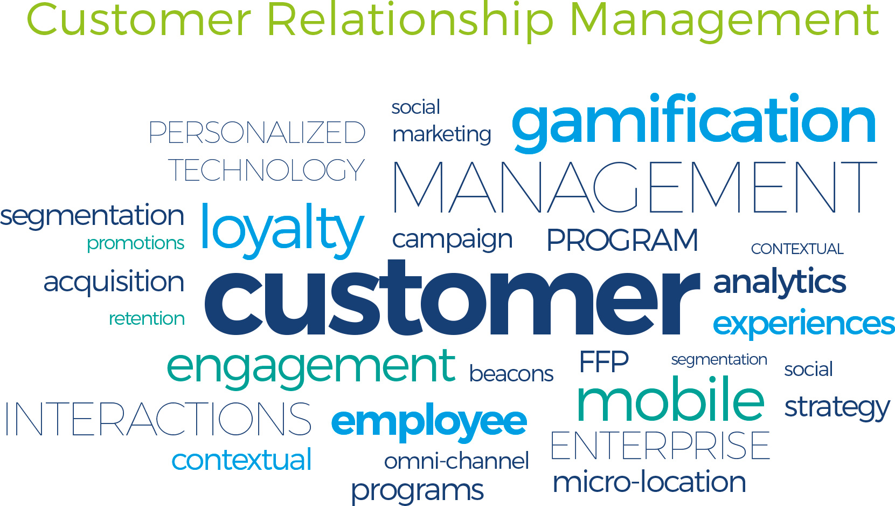
WHAT IS COMARCH CRM&MARKETING?

Slide 8

COMARCH CRM&MARKETING
A comprehensive suite of business applications and professional services that helps enterprises:
build and manage gamified loyalty programs
create rich consumer experiences and personalized interactions across multiple touch points
automate marketing processes and ultimately boost profits

Slide 9
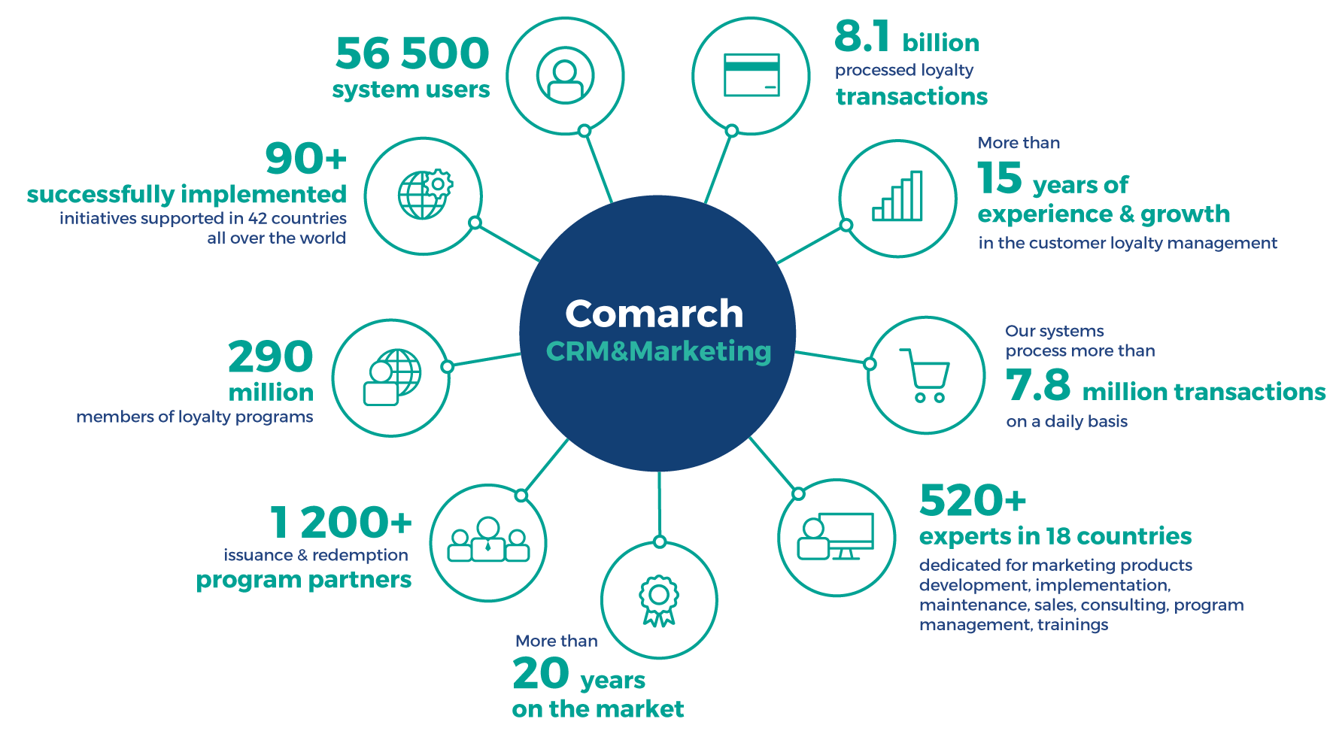
COMARCH CRM&MARKETING IN NUMBERS

Slide 10
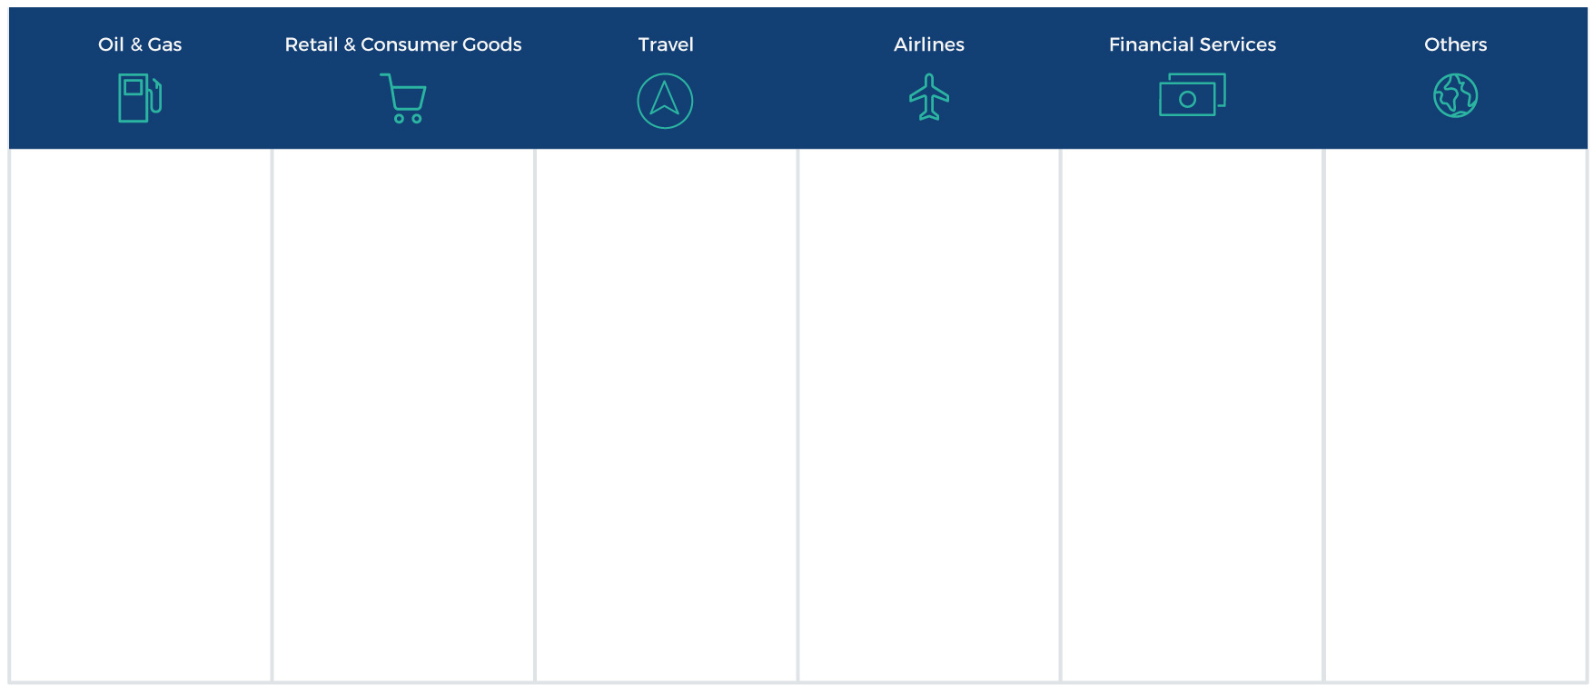
































CLIENTS WHO HAVE TRUSTED US

Slide 11
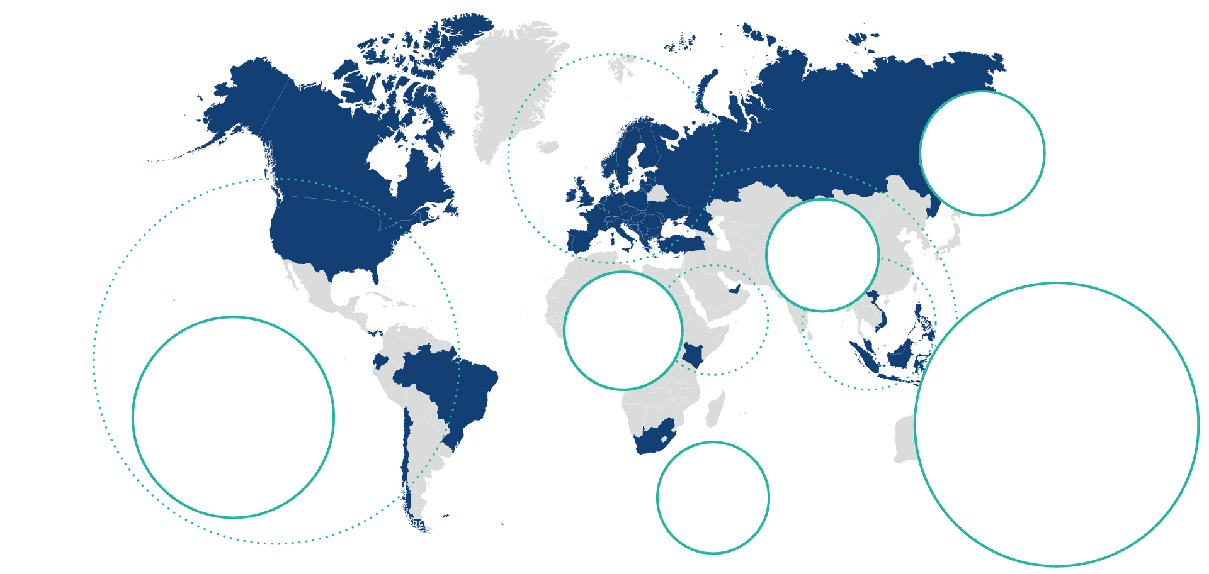



























COMARCH CRM&MARKETING SELECTED CLIENTS

Slide 12

SUCCESS STORIES

Slide 13

OIL&GAS

Slide 14


COMARCH LOYALTY MANAGEMENT @BRITISH PETROLEUM
BUSINESS CHALLENGES:
help strengthen customer loyalty & keep their current customer base
increase sales with current BP customers & gain new customers
increase the company’s prestige by building individual relationships with customers
increase sales of non-petrol products
decrease marketing costs
improve time-to-market
gain an competitive advantage by bringing in a innovative card and mobile based solutions (Iberia)

Slide 15
COMARCH LOYALTY MANAGEMENT @BRITISH PETROLEUM
SCOPE OF THE PROJECT:
scheme adapted to each country’s specifics (8 European countries)
fuel and non fuel processing
integrated with Payback and Nectar loyalty
implementation of:
Comarch Loyalty Management
Comarch BI
modules: Business Administration, Contact Center, Logistic Module, B2B Module, On-site Application, Mobile App.
hosted in CDC in Kraków

Slide 16
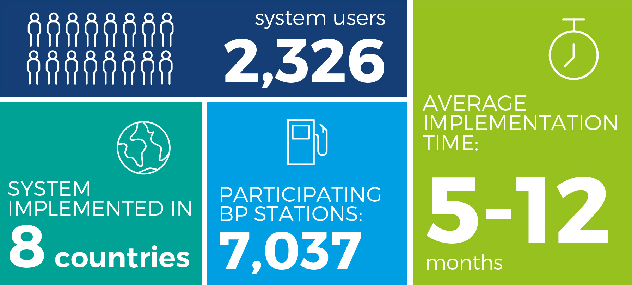
SUCCESS STORY: BRITISH PETROLEUM – FACTS & FIGURES

Slide 17
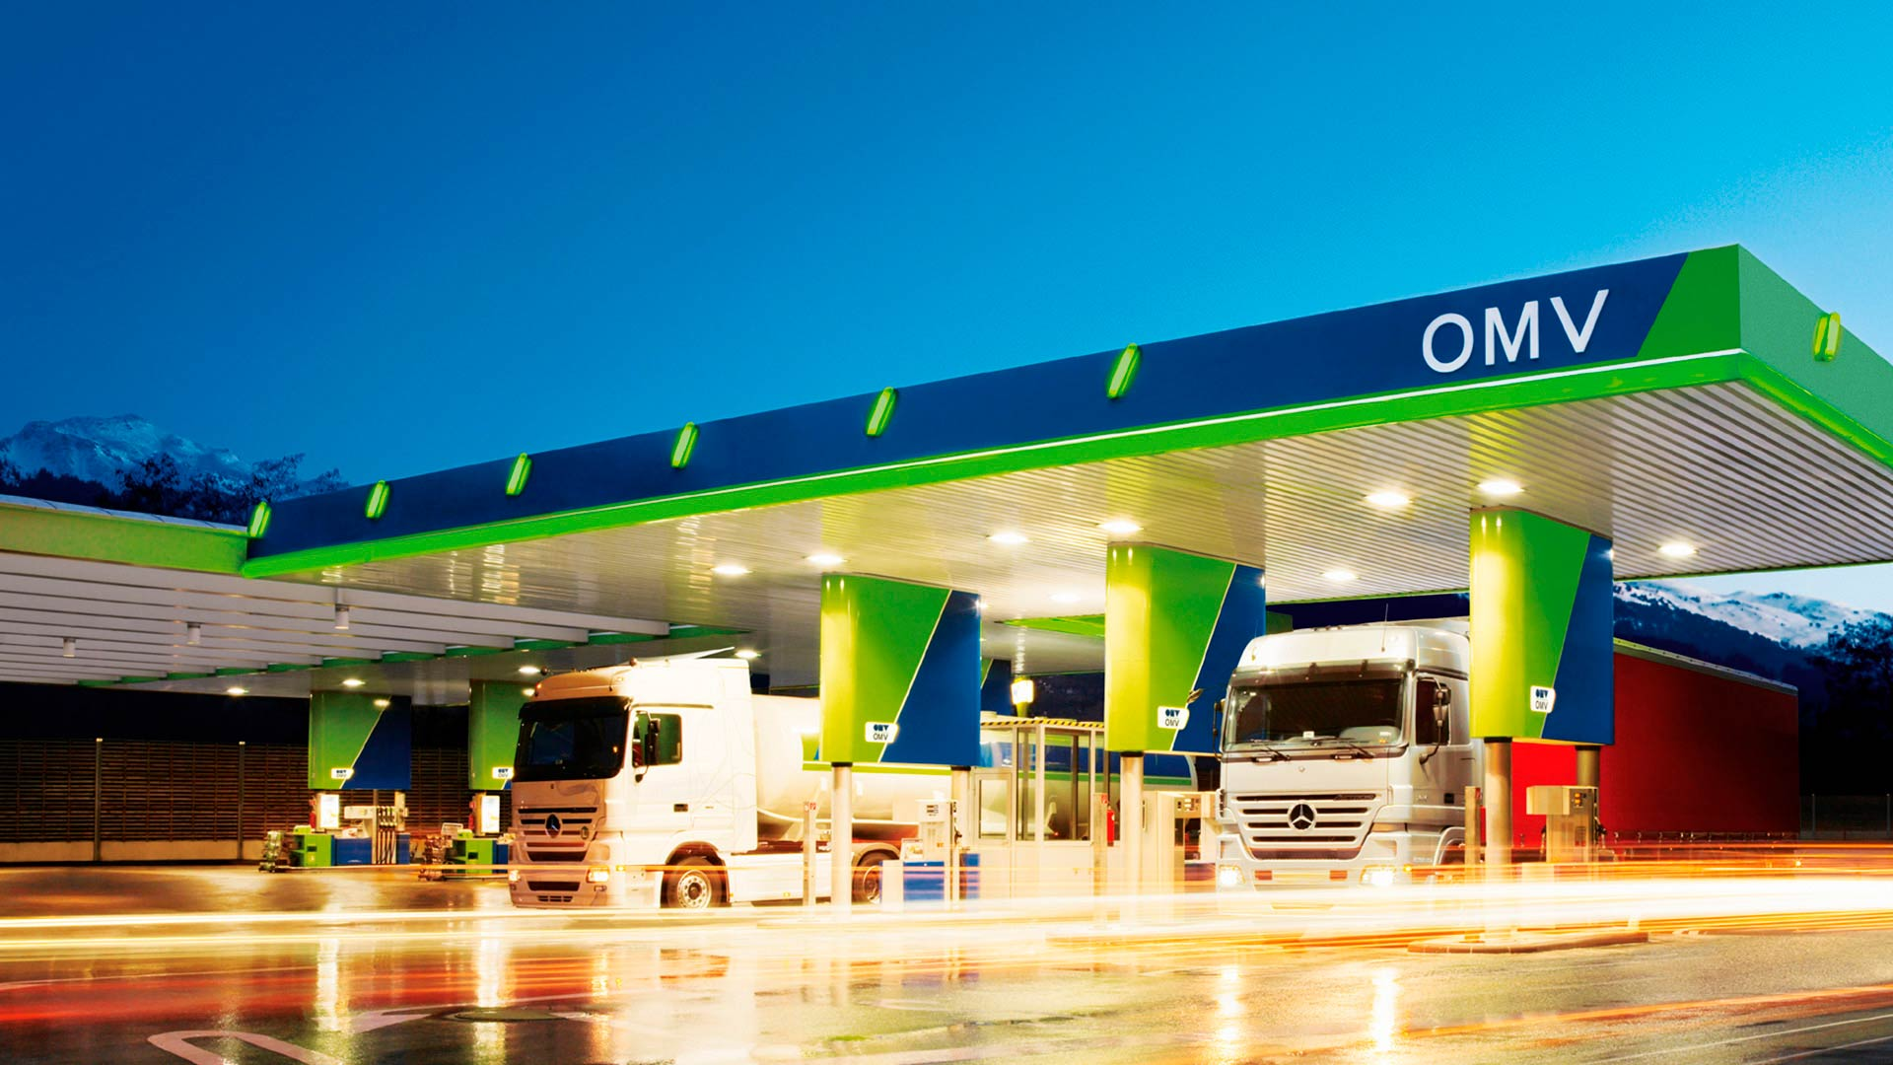

COMARCH LOYALTY MANAGEMENT @OMV
ABOUT OMV:
integrated, international oil & gas company, headquartered in Vienna
Austria’s largest listed industrial company
3,800 filling stations in 11 countries
1.5 million people use one of OMV’s filling stations every day

Slide 18
COMARCH LOYALTY MANAGEMENT @OMV
BUSINESS CHALLENGES:
offer consistent program branding and positioning
provide special treatment of customers
generate customers’ trust
secure operational excellence
differentiate from competition with innovative and diversified offers
4 pillars of loyalty program:
simplicity
rich variety of promotions
appealing communication
VIP treatment of best clients

Slide 19
COMARCH LOYALTY MANAGEMENT @OMV
SCOPE OF THE PROJECT:
implemented in: Slovenia and Slovakia
Comarch Loyalty Management with mobile loyalty application
modules: Business Administration, Call Center and the CMS based Customer Web Application
integration with OMV internal systems (POS, SAP, ECR)
integration with external service providers

Slide 20

„
In the first months after the launch of the program we have already seen positive effects – Over half a million customers joined SMILE & DRIVE program and the number of participants is steadily growing. We see a positive effect due to the customer insight gained from the program, as we are able to spend marketing budget more efficiently.
Julia Sandor - International Loyalty Manager at OMV

Slide 21

RETAIL & CONSUMER GOODS (FMCG)

Slide 22


COMARCH LOYALTY MANAGEMENT @X5 RETAIL GROUP
ABOUT X5 RETAIL GROUP:
the largest retail chain in Russia, in terms of sales
5,400 stores across Russia
BUSINESS CHALLENGES:
create programs to reward the most loyal supermarket and hypermarket customers for their purchases
build a loyalty program scheme supported by an effective and modern IT solution

Slide 23
COMARCH LOYALTY MANAGEMENT @X5 RETAIL GROUP
SCOPE OF THE PROJECT:
2 independent loyalty programs
in 2015, the Klub Perekrestok program had 15 partners - market leaders as: S7 Airlines and Citibank
solution & modules: Comarch Loyalty Management (Business Administration, Customer Web Application, Contact Center, B2B)
consulting, implementation, hosting and DRC services

Slide 24
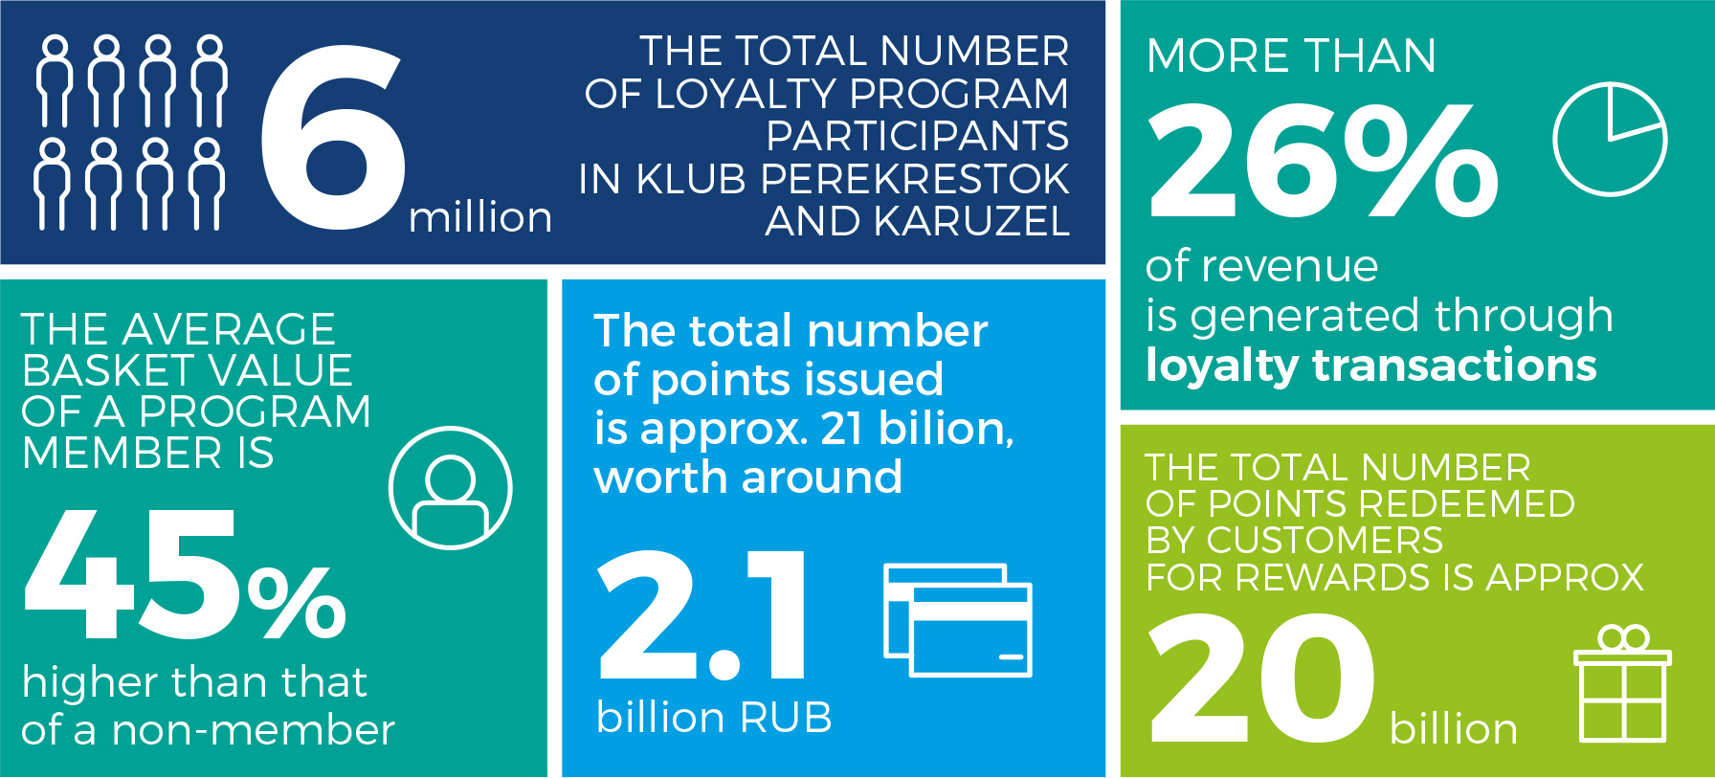
SUCCESS STORY: X5 RETAIL GROUP – FACTS & FIGURES

Slide 25


SUCCESS STORY @LEROY MERLIN POLAND
BUSINESS CHALLENGES:
create a system for an innovative loyalty program that will identify the group of most valuable customers
a need for advanced, multi-stage marketing campaigns
run campaigns directly from individual stores (43 stores)
operation in a mix of on- and offline modules (earn & burn)

Slide 26
SUCCESS STORY @LEROY MERLIN POLAND
SCOPE OF THE PROJECT:
solutions: Comarch Loyalty Management (Business Administration, Customer Web Application, Application for Customer Service Offices) Comarch Campaign Management
analytical services
implementation, maintenance and support

Slide 27

TRAVEL

Slide 28


COMARCH LOYALTY MANAGEMENT & MANAGED SERVICES @LONDON HEATHROW
ABOUT LONDON HEATHROW:
world’s busiest airport in Europe (75 million passengers in 2015)
home of British Airways
strong financial performance in 2015 with revenue of £2,765 million
re-launch of previous loyalty programme – ”World of Points” ”Heathrow Rewards”

Slide 29
COMARCH LOYALTY MANAGEMENT & MANAGED SERVICES @LONDON HEATHROW
SCOPE OF THE PROJECT:
Comarch Loyalty Management
modules: Business Administration, Contact Center, Member Portal and Business to Partner
responsive website (web + mobile)
complex integration: all touch points at the airport feeding data loyalty hub
Program Management is being conducted by Comarch marketing and analytical specialists
additional services of operational management
analysis & promotion suggestions
Call Center and Partner Management

Slide 30
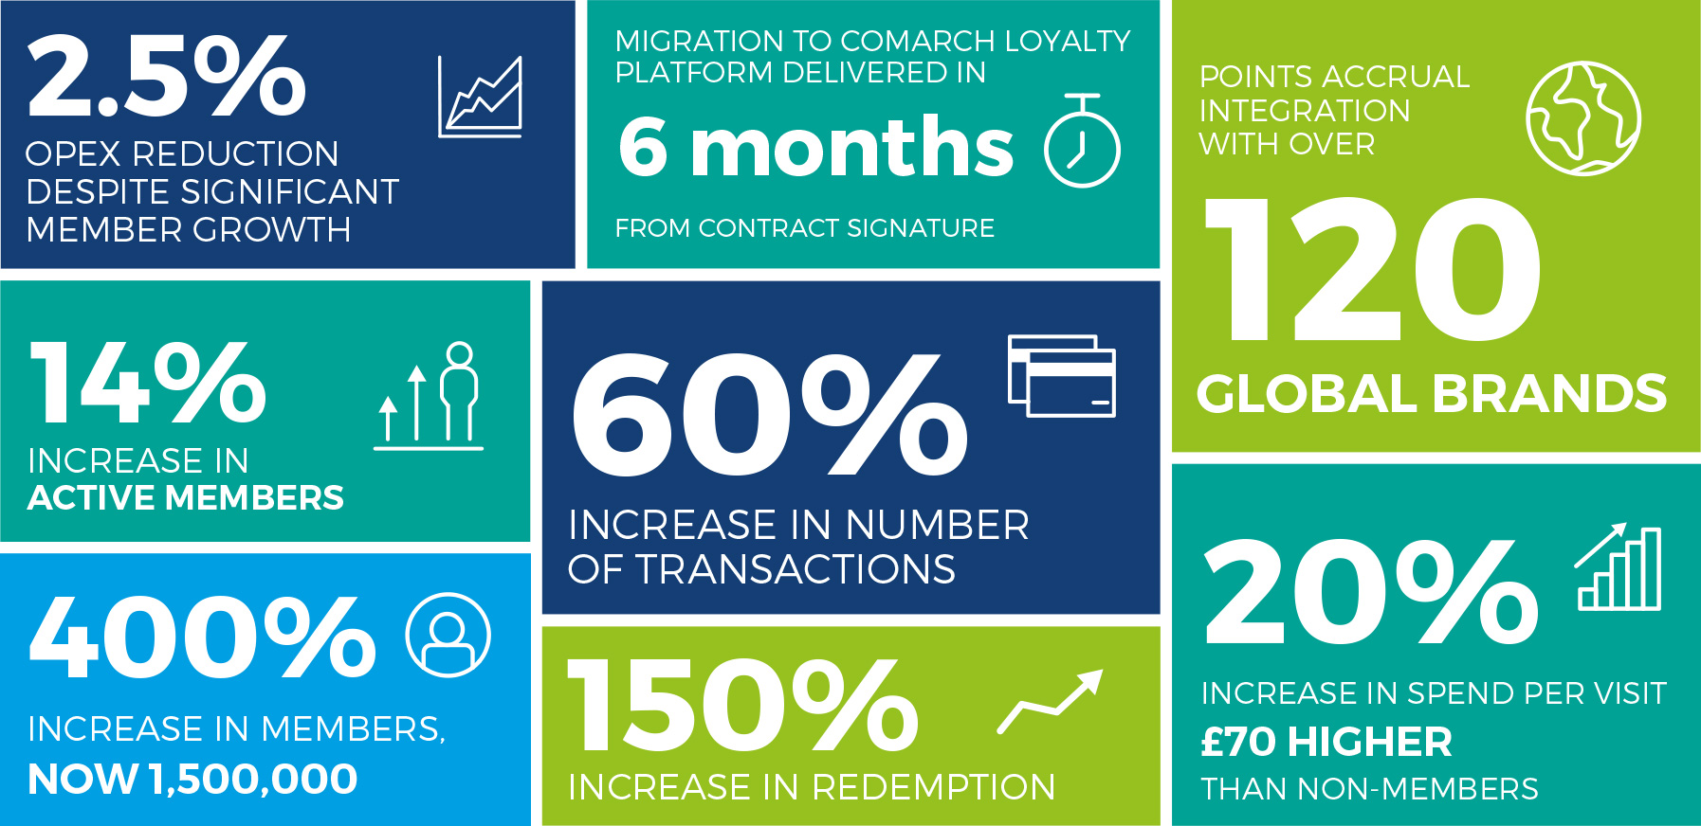
SUCCESS STORY: LONDON HEATHROW – FACTS AND FIGURES

Slide 31


COMARCH LOYALTY MANAGEMENT @ENTERPRISE RENT-A-CAR
ABOUT ENTERPRISE RENT-A-CAR:
American based car-rental chain
7,200 car pick-up points in the US, Canada, UK, Ireland, Germany
car rental, leasing, vanpooling, car sharing and hourly rental program
fleet that consists of over 120 car types and models

Slide 32
COMARCH LOYALTY MANAGEMENT @ENTERPRISE RENT-A-CAR
BUSINESS CHALLENGES:
a loyalty tracking solution able to support a large-scale program platform with the capability of serving millions of members
ability to utilize the system with minimal hardware investment – a PaaS model where a vendor is set to maintain and host the provided hardware, software and other services
experience in serving clients from the travel sector

Slide 33
COMARCH LOYALTY MANAGEMENT @ENTERPRISE RENT-A-CAR
SCOPE OF THE PROJECT:
Comarch Loyalty Management Travel Edition
3 modules: Business Administration, Contact Center and Member Portal

Slide 34
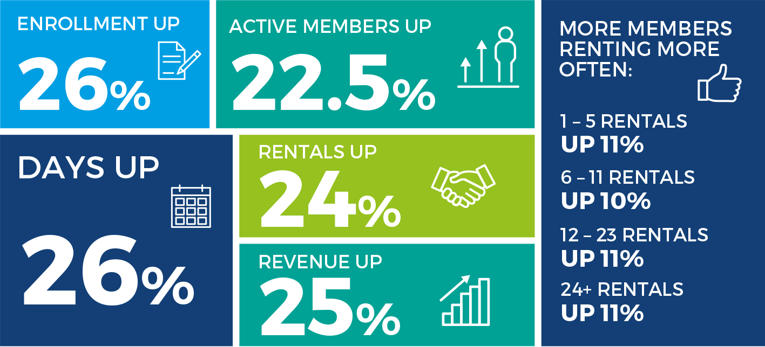
SUCCESS STORY: ENTERPRISE RENT-A-CAR – FACTS AND FIGURES

Slide 35

AIRLINES

Slide 36
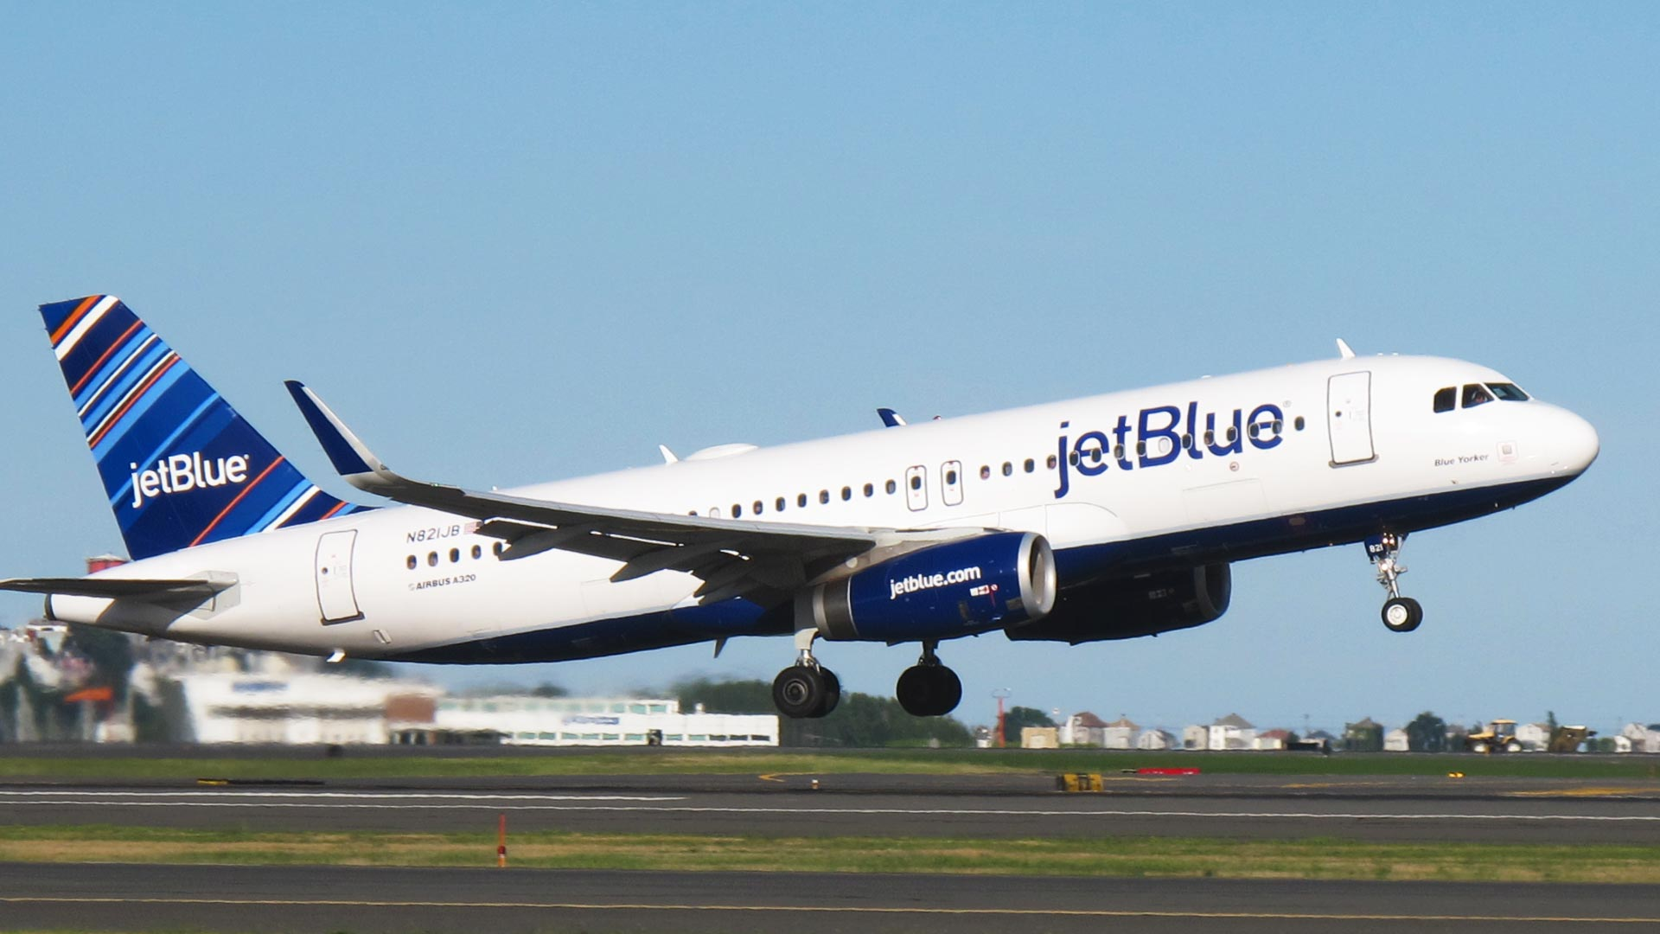




SUCCESS STORY @JETBLUE AIRWAYS
ABOUT JETBLUE AIRWAYS:
American hybrid / low-cost carrier
loyalty program - True Blue
has its own terminal (T5) at JFK
offers flights to 90+ destinations
leader in using the latest technologies
"Innovation by Design" Award Fast Company (2015)
„Top Low Cost Airline for Customer Satisfaction” JD Power and Associates (2015)

Slide 37
SUCCESS STORY @JETBLUE AIRWAYS
SCOPE OF THE PROJECT:
Comarch Loyalty Management for Airlines
modules: Business Administration, Contact Center and Member Portal
Comarch Smart Analytics
Comarch Customer Engagement
hosted in Comarch Data Center in Chicago
simultaneous replacement of Loyalty, Revenue Accounting, Internet Booking Engine
migration of 8 million accounts and over 60 million transactions
integration with Navitaire, Sabre, Mercator, hotel partner (Hilton, Marriott), a co-branded credit card (AmEx), 18 diversified accrual partners

Slide 38


SUCCESS STORY @AZUL Brazilian Airlines
BUSINESS CHALLENGES:
industry-tailored IT product that meets specific airline needs
revenue-based accrual scheme
empowerment of Elite Tiers
Business Intelligence tool for FFP analysis

Slide 39
SUCCESS STORY @AZUL Brazilian Airlines
SCOPE OF THE PROJECT:
Comarch Loyalty Management for Airlines
modules: Business Administration, Contact Center and Member Portal
Comarch Smart Analytics
Hosted by Azul
replacement of Navitaire Loyalty Management System (Azul was the first and only user)
migration of accounts and transactions
integration with Navitaire, Serasa and Address database
integration with 5+ accrual partners

Slide 40

OTHER INDUSTRIES

Slide 41

INDUSTRY TRENDS – WHAT’S HOT IN MARKETING & LOYALTY

Slide 42
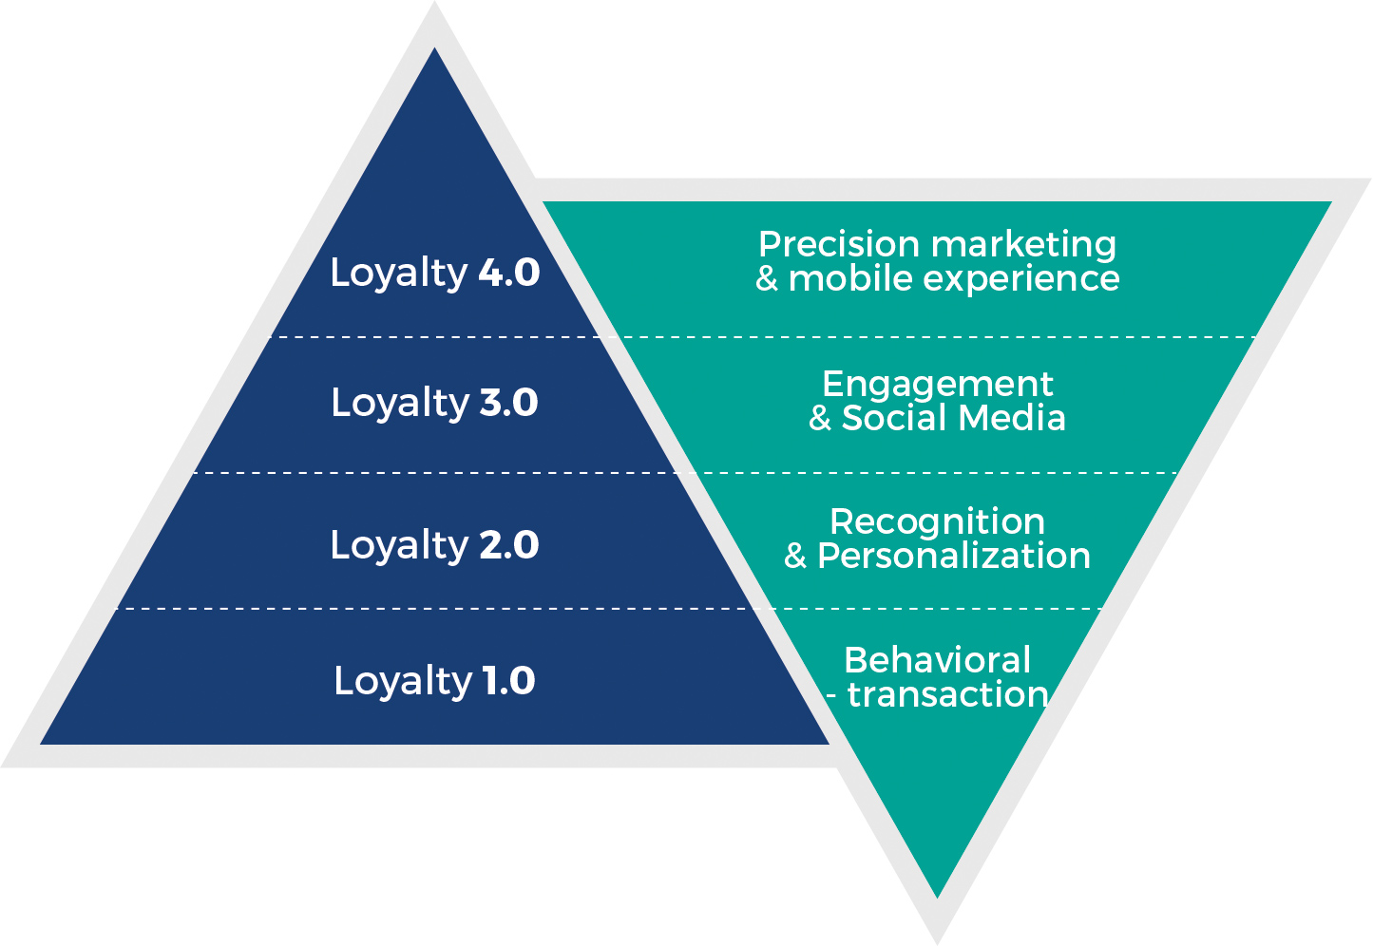
HOW WE UNDERSTAND LOYALTY…

Slide 43

COMARCH - WHERE WE ARE DIFFERENT

Slide 44
WE BASE ON YEARS OF EXPERIENCE
Comarch Loyalty Management goes mobile – Mobile Application as the new communication and customer experience channel
Comarch Loyalty Management received the maximum score in the MJA Associates benchmarking
New product Comarch Loyalty Management for Airlines powers FFPs and 1st implementation at S7 Airlines in Russia
CLM obtains a certificate of compliance with PCI-DSS and PABP
Entrance into banking industry
Comarch Loyalty Management idea for retail & fuel market
2005
2009
2000-2002
2008
2011
The first contract of Comarch CRM&Marketing in BP Polska
Comarch CRM&Marketing entrance into foreign markets – global contract with BP
Two new products: Comarch Campaign Management and Comarch Smart Analytics are introduced

Slide 45
WE BASE ON YEARS OF EXPERIENCE
Introduction of a comprehensive range of managed services in the portfolio
Micro-location technology Comarch Beacons integrated with Comarch Loyalty Management
New redesigned Mobile App for program members
Comarch Customer Care introduced in the portfolio
Comarch as a leading vendor in the newest report: “The Forrester Wave: Customer Loyalty Solutions for Large Organizations Q1 2016”
2013
2015
2012
2014
2016
New innovative offer of worlds first airport centric coalition of loyalty programs
Comarch CRM&Marketing in Gartner’s report “Market Guide for Loyalty Marketing Platforms”
New modules: Data Hub and In-Store App
Comarch Loyalty Management 5.0 is released with new technology, redesigned interface and great number of fresh features
New products and services in CRM&Marketing portfolio: Comarch Customer Engagement, Comarch Social Mining and Creative Services

Slide 46




COMARCH SOLUTIONS RECOGNIZED BY LEADING INDUSTRY EXPERTS
PURPOSE-BUILT SOLUTIONS FOR CUSTOMER LOYALTY, WITH FUNCTIONALITY TO SUPPORT A FULL RANGE OF LOYALTY REQUIREMENTS
STRONG AND DISCIPLINED TECHNOLOGY PARTNER
DISTINGUISHED BY FORRESTER RESEARCH AND GARTNER
GLOBAL LOYALTY TECHNOLOGY EXPERIENCE
END-TO-END LOYALTY SOLUTION FOR LARGE ORGANIZATIONS

Slide 47
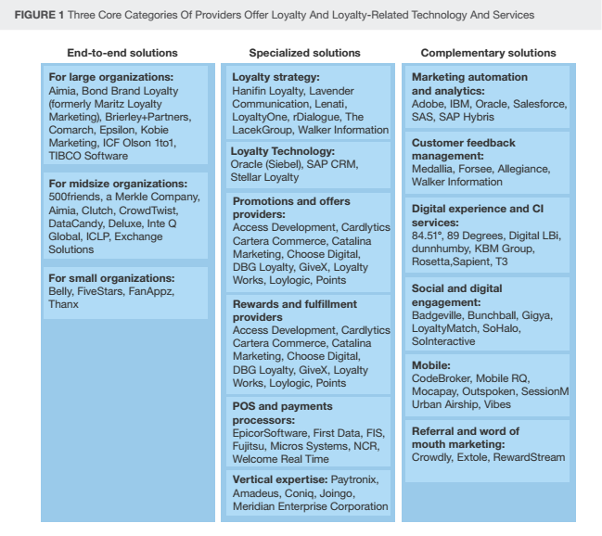
COMARCH - MATURE END-TO-END LOYALTY SOLUTIONS FOR LARGE ORGANIZATIONS
Source: The Forrester Wave™: Customer Loyalty Solutions For Large Organizations, Q1 2016

Slide 48

„
Krakow-based Comarch certainly brings strong loyalty management capabilities to the market through its products and experience managing large partner programs for airlines, travel, and oil and gas companies. Clients are very satisfied with Comarch’s value and call out the ease of technology implementation and industry expertise. As one client said: “We really liked that they could . . . adapt to the uniqueness of our business.”
Forrester Research

Slide 49
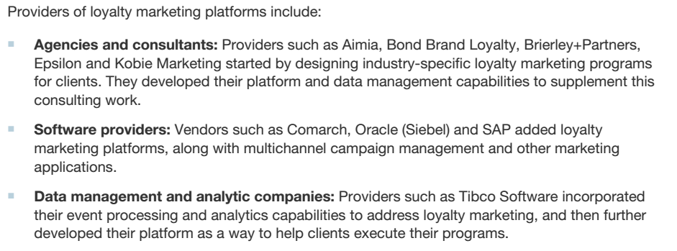
COMARCH IN GARTNER’S MARKET GUIDE FOR LOYALTY MARKETING PLATFORMS
Source: Market Guide for Loyalty Marketing Platforms 2015

Slide 50

Consider If: You need multiple loyalty management program options, coalition, single-company, as well multiple technology deployment options (such as hosted and on-premises).
Gartner

Slide 51
ANALYSTS COVERAGE
RESEARCH COMPANY | SELECTED REPORTS
Gartner www.gartner.com | The Gartner CRM Vendor Guide, 2016 Hype Cycle for Digital Commerce, 2015 Hype Cycle for Digital Marketing, 2015 Market Guide for Loyalty Marketing Platforms, 2015 The Gartner CRM Vendor Guide, 2015 Key Customer Experience Foundations for Marketing Leaders, 2015 The Gartner CRM Vendor Guide, 2014 Hype Cycle for CRM Marketing Applications, 2012
Forrester Research www.forrester.com | The Forrester Wave: Customer Loyalty Solutions for Large Organizations Q1 2016 Understanding the Anatomy of a Loyalty Technology Platform, 2012 The Customer Loyalty Ecosystem, 2011

Slide 52

UNIQUE SELLING POINTS

Slide 53
COMARCH - WHERE WE ARE DIFFERENT
PROOFED & CONFIGURABLE SOLUTIONS WITH POWERFUL CAPABILITIES
Powerful engine - fully scalable platform that grows with your business
Robust program rules definition
Real-time experience - real-time accrual and redemption of points/miles, as well as coupon issuance and marketing communication
Very strong capabilities in managing partners within the airline coalition or multi-partner loyalty program

Slide 54
COMARCH - WHERE WE ARE DIFFERENT
END-TO-END PORTFOLIO
Comprehensive, end-to-end loyalty offer
Integrated micro-location technology - Comarch Beacon provides personalized consumer experiences & improved targeting offers
Integrated engagement solution
Creative touch - rich user experience and state-of-the-art graphic design

Slide 55
COMARCH - WHERE WE ARE DIFFERENT
END-TO-END PORTFOLIO
EASY IMPLEMENTATION & INDUSTRY EXPERTISE
Support of diversified loyalty program business models
Broad multi-industry experience - various industries and many types of loyalty schemes in stand-alone, multi-partner, coalition model
Robust API - easy access to valuable data
Quick, flexible and in-house delivery

Slide 56

COMARCH CRM&MARKETING PLATFORM OVERVIEW

Slide 57
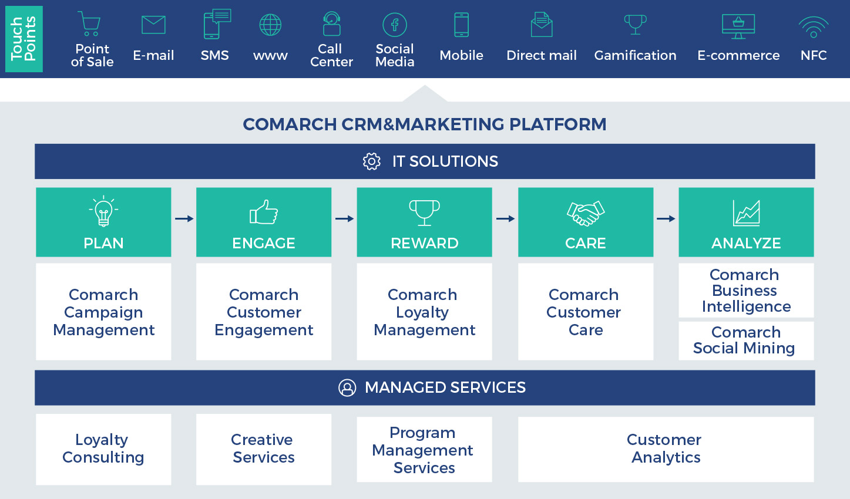
COMARCH CRM&MARKETING – WHERE LOYALTY AND ENGAGEMENT MEET INNOVATION

Slide 58

COMARCH LOYALTY MANAGEMENT – SOLUTION OVERVIEW

Slide 59
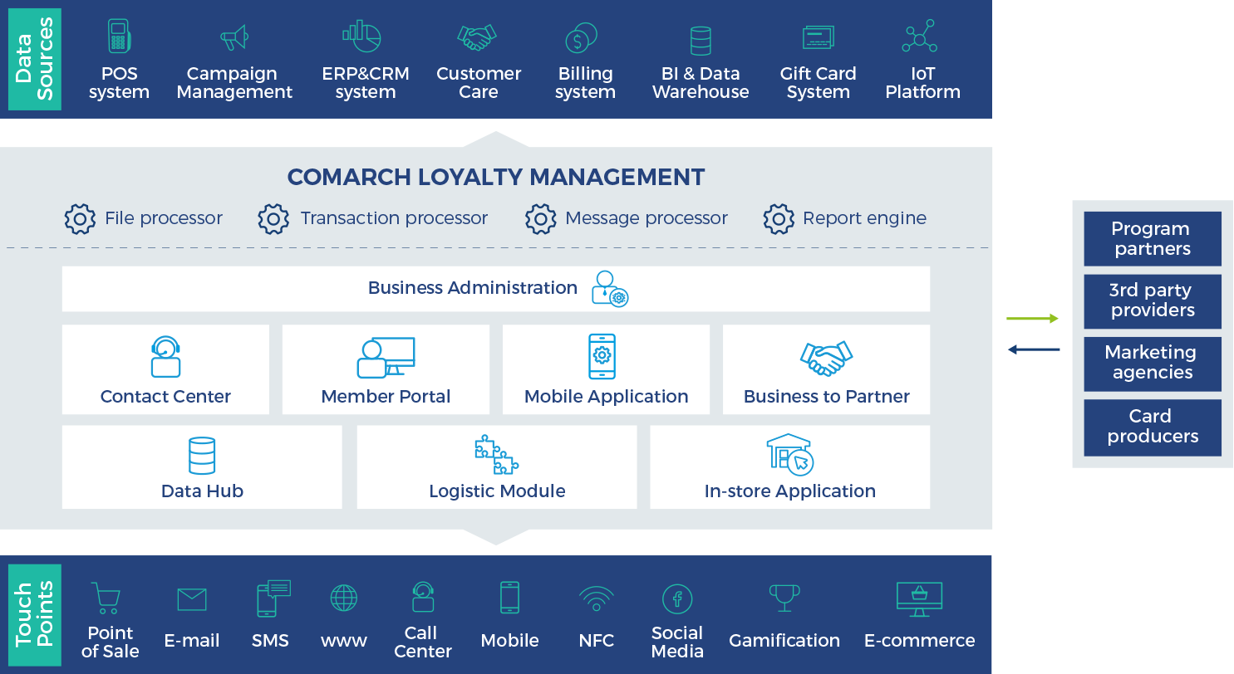
COMARCH LOYALTY MANAGEMENT – SOLUTION OVERVIEW
v

Slide 60

KEY SYSTEM CAPABILITIES
multi-language support
web-based (no local installation requires)
no IT skills needed
real time data processing
multi-tenancy

Slide 61
DIFFERENT LOYALTY MODELS IN ONE SOLUTION
COMARCH LOYALTY MANAGEMENT
Multipartner loyalty programs & coalitions
Stand-alone loyalty programs
Frequent flyer programs
Employees incentive programs
B2C/ B2B loyalty programs

Slide 62
BUSINESS MODULES TAILORED TO DIFFERENT USERS
COMARCH LOYALTY MANAGEMENT
BUSINESS ADMINISTRATION
CONTACT CENTER
MEMBER PORTAL
MOBILE APPLICATION
BUSINESS TO PARTNER
DATA HUB
LOGISTIC MODULE
IN-STORE APPLICATION

Slide 63
BUSINESS MODULES TAILORED TO DIFFERENT USERS
COMARCH LOYALTY MANAGEMENT
BUSINESS ADMINISTRATION
CONTACT CENTER
MEMBER PORTAL
MOBILE APPLICATION
BUSINESS TO PARTNER
DATA HUB
LOGISTIC MODULE
IN-STORE APPLICATION

Slide 64
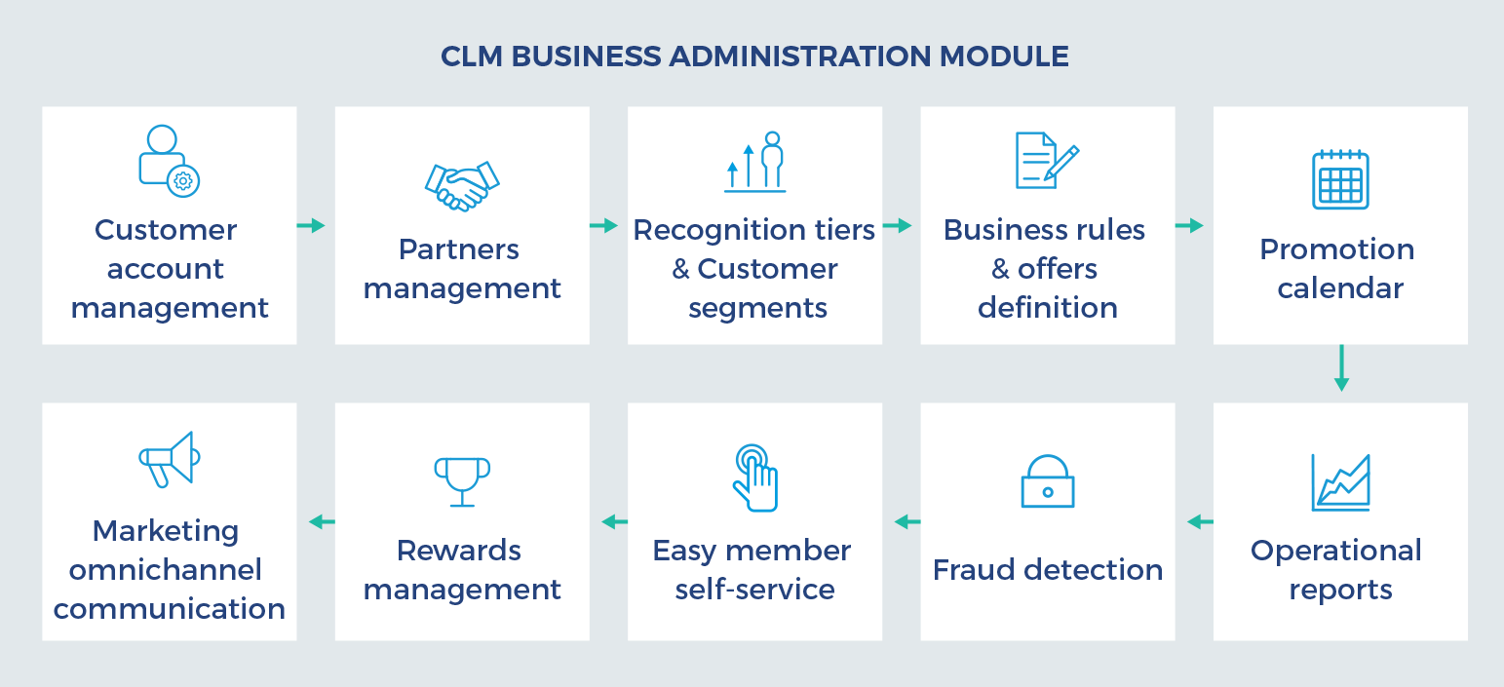
KEY FEATURES
BUSINESS ADMINISTRATION
CONTACT CENTER
MEMBER PORTAL
MOBILE APPLICATION
BUSINESS TO PARTNER
DATA HUB
LOGISTIC MODULE
IN-STORE APPLICATION

Slide 65
PROMOTION RULE CONFIGURATION
BUSINESS ADMINISTRATION
CONTACT CENTER
MEMBER PORTAL
MOBILE APPLICATION
BUSINESS TO PARTNER
Time range
Partners/sites assignment
Parameters
Source event
Conditions
Segments assignment
Resulting event
DATA HUB
LOGISTIC MODULE
IN-STORE APPLICATION

Slide 66
ROBUST CURRENCY MECHANISM
unlimited point types
different expirations for various point types
different ratios
different points defined per partner
various points features (transferable, adjustable, purchasable)

Slide 67
GOING FAR BEYOND POINTS
TRANSACTION PROCESSING
BUSINESS ADMINISTRATION
SOURCE EVENT
RESULTING EVENT
CONTACT CENTER
points conversion
customer attribute changed
balance inquiry
redemption
member-get-member
points correction
points expiration
customer sign-in
redemption refund
customer registration
transaction reversal
customer survey
coupon redemption
points transfer donor
ticket redemption
ticket upgrade
points purchase
points transfer acceptor
attribute
benefit
counter
coupon
discount
points
message
notification
recognition
error
promoter profit
lottery
grace period
MEMBER PORTAL
MOBILE APPLICATION
BUSINESS TO PARTNER
DATA HUB
LOGISTIC MODULE
IN-STORE APPLICATION

Slide 68

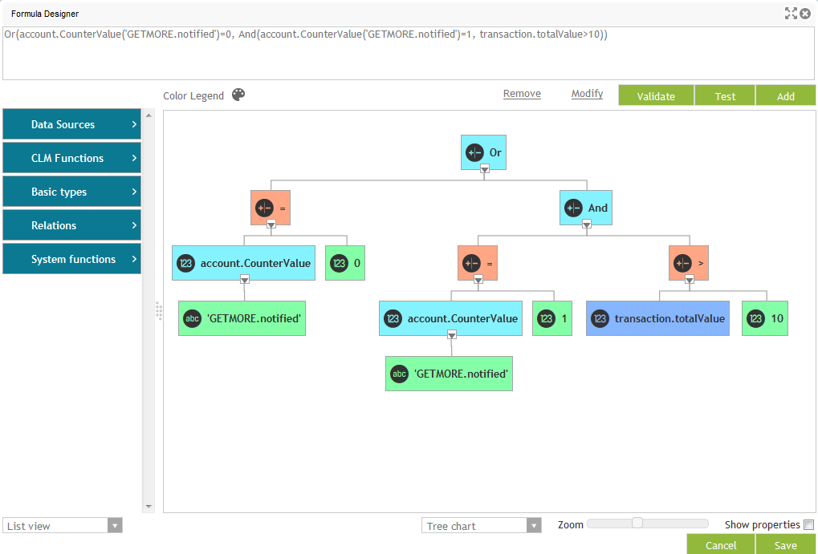
POWERFUL PROMOTION DESIGNER
BUSINESS ADMINISTRATION
account/customer/ identifier levels
drag-and-drop designer
CONTACT CENTER
MEMBER PORTAL
MOBILE APPLICATION
extracting functions: relations, logic, math and text
BUSINESS TO PARTNER
rules testing and validation
DATA HUB
LOGISTIC MODULE
IN-STORE APPLICATION

Slide 69
UNLIMITED POSSIBILITIES OF REWARDING
BUSINESS ADMINISTRATION
PROMO TYPES
PROMO BENEFITS
CONTACT CENTER
basic points rules
event based
cumulative
cross-selling
multi-partner promotions
member gets members
points
discounts
coupons / vouchers
increased counter
change in Elite Tiers
defined communication
lottery
MEMBER PORTAL
MOBILE APPLICATION
BUSINESS TO PARTNER
DATA HUB
LOGISTIC MODULE
IN-STORE APPLICATION

Slide 70
RECOGNITION TIERS
BUSINESS ADMINISTRATION
CONTACT CENTER
assignment of statuses/tiers as an additional loyalty incentive
combination of privileges and special rules
fully configurable conditions for entering a specified level
MEMBER PORTAL
MOBILE APPLICATION
BUSINESS TO PARTNER
DATA HUB
LOGISTIC MODULE
IN-STORE APPLICATION

Slide 71
OMNI-CHANNEL CUSTOMER INTERACTION
BUSINESS ADMINISTRATION
PUSH NOTIFICATIONS
With landing page
CONTACT CENTER
Lotteries
Facebook
Mobile application
MEMBER PORTAL
CLM
Surveys
E-MAIL
Call Center
With landing page
MOBILE APPLICATION
Marketing action
Website
Mail
Offers
BUSINESS TO PARTNER
INTERACTIVE MESSAGES
Coupon
Based on geolocation and beacons
DATA HUB
Event message
LOGISTIC MODULE
Message
POS MESSAGES
IN-STORE APPLICATION

Slide 72
COMMUNICATION POSSIBILITIES
various kinds of messaging triggers (marketing actions, events, periodic communication, etc.)
automatic system verification of appropriate customer permissions
content in different language versions, supports HTML markup
created templates stored for various domains (system, customer, social, lottery and marketing notifications)
message tracking
BUSINESS ADMINISTRATION
CONTACT CENTER
MEMBER PORTAL
MOBILE APPLICATION
BUSINESS TO PARTNER
DATA HUB
LOGISTIC MODULE
IN-STORE APPLICATION

Slide 73

CUSTOMER SEGMENTATION
many possible customer segmentations based on all available attributes, statistics and transaction details
association with previously created segments or imported from 3rd party systems
segment control group for testing purposes before targeted actions
BUSINESS ADMINISTRATION
CONTACT CENTER
MEMBER PORTAL
MOBILE APPLICATION
BUSINESS TO PARTNER
DATA HUB
LOGISTIC MODULE
IN-STORE APPLICATION

Slide 74

CUSTOMER SEGMENTATION
many possible customer segmentations based on all available attributes, statistics and transaction details
association with previously created segments or imported from 3rd party systems
segment control group for testing purposes before targeted actions

Slide 75
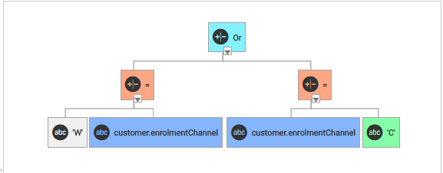
EASY-TO-USE SEGMENTATION TOOL
BUSINESS ADMINISTRATION
advanced graphical segment designer tool or SQL query used for segment definition
automatic refreshing periods
CONTACT CENTER
MEMBER PORTAL
MOBILE APPLICATION
BUSINESS TO PARTNER
maximum size and ranking formula capabilities
DATA HUB
LOGISTIC MODULE
IN-STORE APPLICATION

Slide 76
REWARDS MANAGEMENT
BUSINESS ADMINISTRATION
fully configurable price plans of rewards, expressed as:
value in points
mixed price (in money and points)
money
different price plans depending on various transactional aspects (member tier or segment)
communications API for vendors
CONTACT CENTER
MEMBER PORTAL
MOBILE APPLICATION
BUSINESS TO PARTNER
DATA HUB
LOGISTIC MODULE
IN-STORE APPLICATION

Slide 77

REDEMPTION CHANNELS
Mobile App
BUSINESS ADMINISTRATION
CONTACT CENTER
MEMBER PORTAL
3rd party Integration by Webservice
Call Center
MOBILE APPLICATION
REDEMPTION
BUSINESS TO PARTNER
DATA HUB
LOGISTIC MODULE
POS
Online Website
IN-STORE APPLICATION

Slide 78
REWARD TYPES
Physical Rewards
BUSINESS ADMINISTRATION
CONTACT CENTER
MEMBER PORTAL
Gifts Auctions
Services
MOBILE APPLICATION
REWARDS
BUSINESS TO PARTNER
Lottery Rewards
Discounts
DATA HUB
LOGISTIC MODULE
Benefits & Privileges
Coupons
IN-STORE APPLICATION

Slide 79
PARTNER MANAGEMENT
BUSINESS ADMINISTRATION
CONTACT CENTER
partners details, contact persons definition, agreement details
differentation of partnership, statuses and method of points issuance
MEMBER PORTAL
MOBILE APPLICATION
BUSINESS TO PARTNER
issuing, redeeming or mix categories allowed to operate in certain channels
partner specific promotions, campaign creation
DATA HUB
LOGISTIC MODULE
IN-STORE APPLICATION

Slide 80

FRAUD DETECTION & PREVENTION
BUSINESS ADMINISTRATION
FRAUD PREVENTION
FRAUD DETECTION
CONTACT CENTER
MEMBER PORTAL
security at all usage levels
monitoring of transactions and suspicious activities
case creation in Contact Center
points accrual cancellation
account, cardholder or system user blocking
MOBILE APPLICATION
BUSINESS TO PARTNER
DATA HUB
LOGISTIC MODULE
IN-STORE APPLICATION

Slide 81
USERS MANAGEMENT
BUSINESS ADMINISTRATION
USER
Loyalty Program Manager
PROFILE
BA Admin
PRIVILEGES
Report generation
Earn rules creation
……
PROFILE
CC Admin
PRIVILEGES
Report scheduling
Activity creation
……
CONTACT CENTER
MEMBER PORTAL
MOBILE APPLICATION
BUSINESS TO PARTNER
DATA HUB
LOGISTIC MODULE
IN-STORE APPLICATION

Slide 82
BUSINESS MODULES TAILORED TO DIFFERENT USERS
BUSINESS ADMINISTRATION
CONTACT CENTER
MEMBER PORTAL
MOBILE APPLICATION
BUSINESS TO PARTNER
DATA HUB
LOGISTIC MODULE
IN-STORE APPLICATION

Slide 83
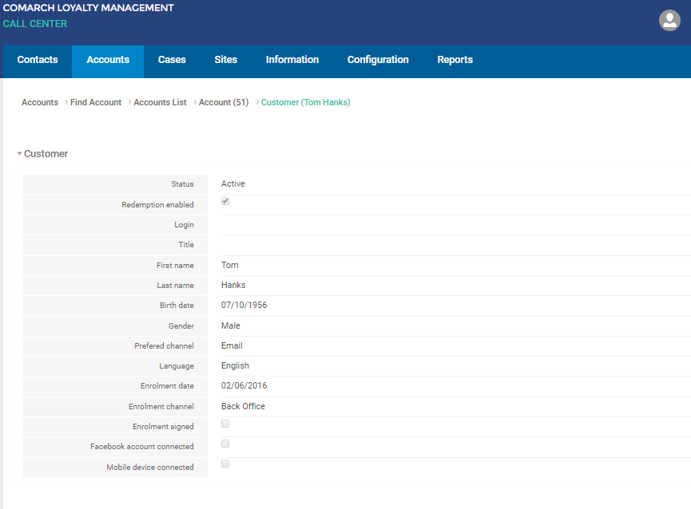
CONTACT CENTER MODULE
BUSINESS ADMINISTRATION
Contact Management
CONTACT CENTER
Customer Profile Data Management
MEMBER PORTAL
Customer Registration
MOBILE APPLICATION
Case Creation & Tracking
BUSINESS TO PARTNER
Sending an E-mail based on Case Type
DATA HUB
LOGISTIC MODULE
Inbound & Outbound Communication with Customers
IN-STORE APPLICATION
Order Management

Slide 84
ACCOUNT/CUSTOMER PROFILE DATA MANAGEMENT
Account Balance
BUSINESS ADMINISTRATION
CONTACT CENTER
MEMBER PORTAL
Orders History
Demographic Data
MOBILE APPLICATION
BUSINESS TO PARTNER
Currently Available Promotions
CUSTOMER PROFILE
Transaction History
DATA HUB
LOGISTIC MODULE
Answers from Surveys
Communication History
IN-STORE APPLICATION

Slide 85
ACCOUNT/CUSTOMER PROFILE DATA MANAGEMENT
New Member Enrolling
BUSINESS ADMINISTRATION
CONTACT CENTER
Managing Inbound/ Outbound Contacts
Editing/Updating Member Data
MEMBER PORTAL
MOBILE APPLICATION
Blocking/Unblocking Accounts and Cards
Redemption
BUSINESS TO PARTNER
CONTACT CENTER
AGENT
DATA HUB
Household Creation
Merging Accounts
LOGISTIC MODULE
Manual Point Correction
Termination of Accounts
IN-STORE APPLICATION

Slide 86
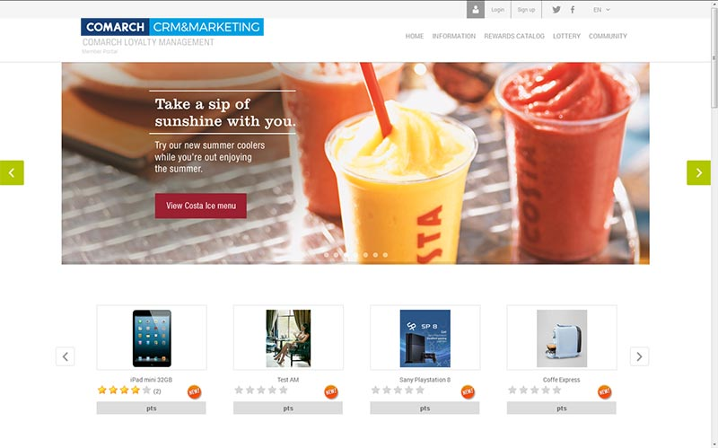
MEMBER PORTAL DEDICATED TO PROGRAM MEMBERS
BUSINESS ADMINISTRATION
Account/profile data management
Reward catalogue management
CONTACT CENTER
Personal stats
Enrollment to the program
MEMBER PORTAL
MOBILE APPLICATION
Progress bar
Login with Facebook/Twitter
BUSINESS TO PARTNER
Ordered/points management
Transaction history & balance inquiry
DATA HUB
Searching for related rewards
Shopping basket
LOGISTIC MODULE
IN-STORE APPLICATION

Slide 87
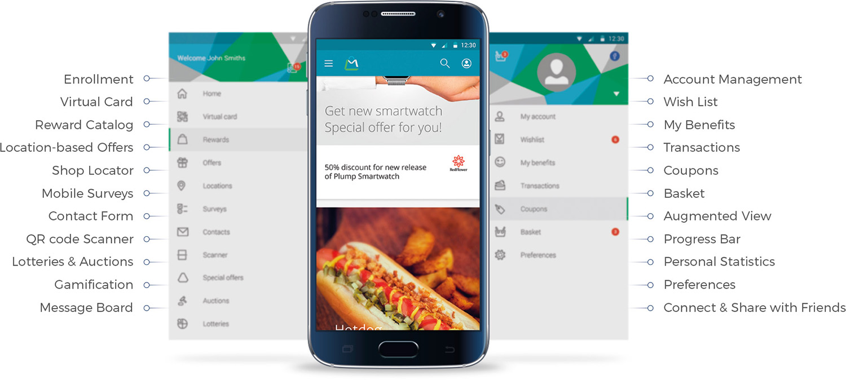
LOYALTY PROGRAMS GO MOBILE
BUSINESS ADMINISTRATION
CONTACT CENTER
MEMBER PORTAL
MOBILE APPLICATION
BUSINESS TO PARTNER
DATA HUB
LOGISTIC MODULE
IN-STORE APPLICATION

Slide 88
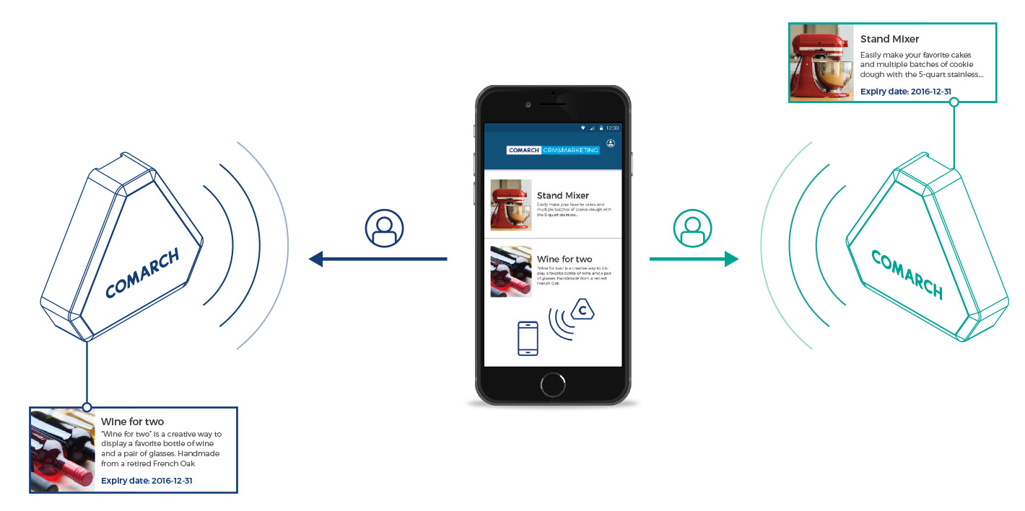
LOCATION-BASED OFFERS
BUSINESS ADMINISTRATION
CONTACT CENTER
MEMBER PORTAL
MOBILE APPLICATION
BUSINESS TO PARTNER
DATA HUB
LOGISTIC MODULE
IN-STORE APPLICATION

Slide 89
PARTNER MANAGEMENT
BUSINESS ADMINISTRATION
RETAIL PARTNER 1
TELCO PARTNER 2
BANKING PARTNER 3
CONTACT CENTER
MEMBER PORTAL
MOBILE APPLICATION
BUSINESS TO PARTNER
DATA HUB
POINTS VALUE
OFFERS
BUSINESS RULES
REPORTS
REQUESTS
LOGISTIC MODULE
IN-STORE APPLICATION

Slide 90

QUICK & EASY INTEGRATION OF NEW PARTNERS
BUSINESS ADMINISTRATION
CONTACT CENTER
MEMBER PORTAL
reducing time and cost of new integrations
streamlining file exchange process
scheduling of file processing
translation of many different file formats
MOBILE APPLICATION
BUSINESS TO PARTNER
DATA HUB
LOGISTIC MODULE
IN-STORE APPLICATION

Slide 91

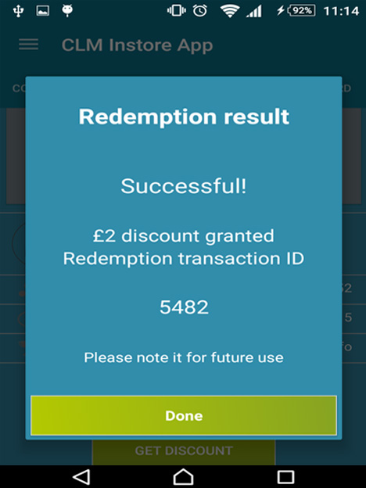
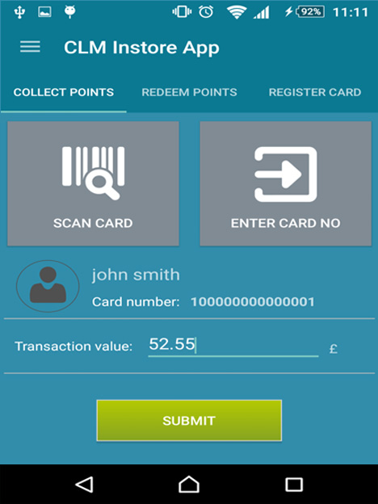
IN-STORE APPLICATION
BUSINESS ADMINISTRATION
Quick enrollment
CONTACT CENTER
MEMBER PORTAL
Member recognition
MOBILE APPLICATION
BUSINESS TO PARTNER
Accrual
DATA HUB
Redemption
LOGISTIC MODULE
IN-STORE APPLICATION

Slide 92

COMARCH LOYALTY MANAGEMENT TRAVEL EDITION – SOLUTION OVERVIEW

Slide 93
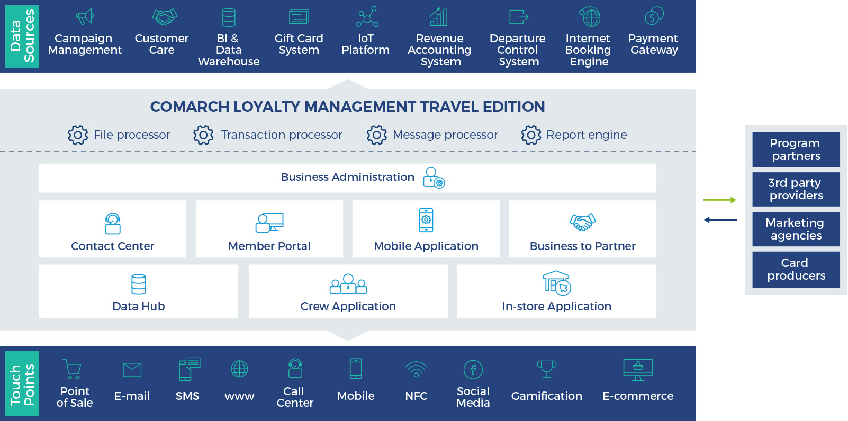

COMARCH LOYALTY MANAGEMENT TRAVEL EDITION – SYSTEM OVERVIEW

Slide 94
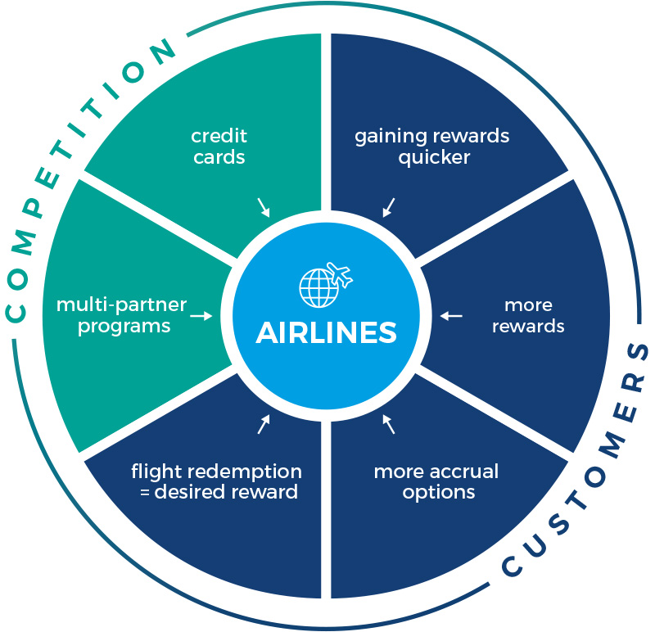
COMPETITIVE TENSION ON AIRLINE LOYALTY PROGRAMS

Slide 95
LOYALTY PROGRAMS MARKET POSITION
Airline loyalty
Multi -partner
ATTRAVTIVENESS & VALUE
Credit cards
FFPs
BRAND (awareness, perception, value, identity, loyalty)

Slide 96
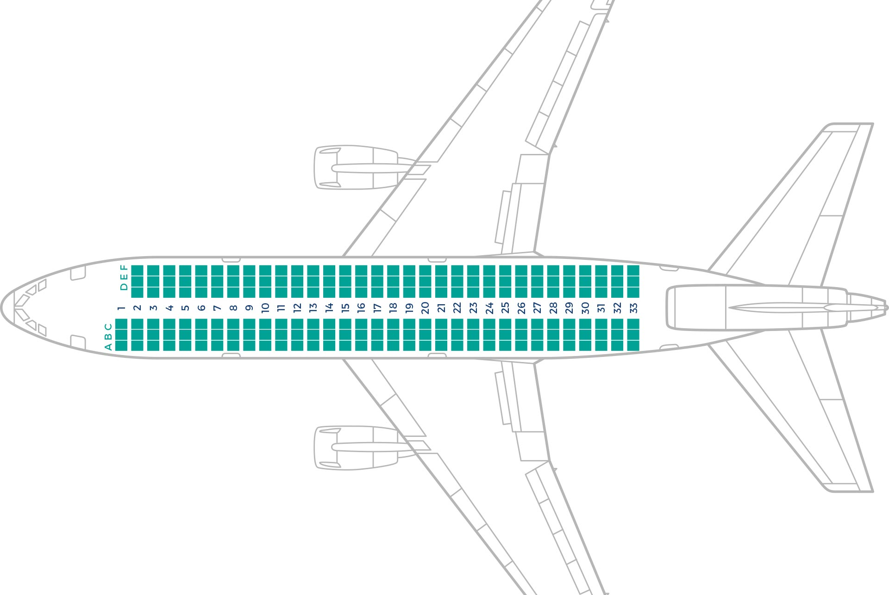
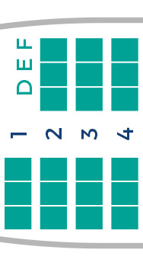
TOP CUSTOMERS – IN SEARCH FOR PRIVILEGES
& RECOGNITIONS
high yield traffic of very frequent travelers
recognition / status
comfort
privileges
looking for status recognition rather than rewards
YIELD / FREQUENCY OF TRAVEL

Slide 97
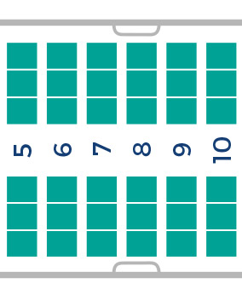
FREQUENT TRAVELLERS – LOOKING FOR STATUS, RECOGNITION, REDEMPTION OPTIONS
frequent travelers
high purchasing power
looking for recognition and privileges
in search for broad accrual possibilities
combining various loyalty programs (FFP and retail) to achieve economy of scale effect
YIELD / FREQUENCY OF TRAVEL

Slide 98
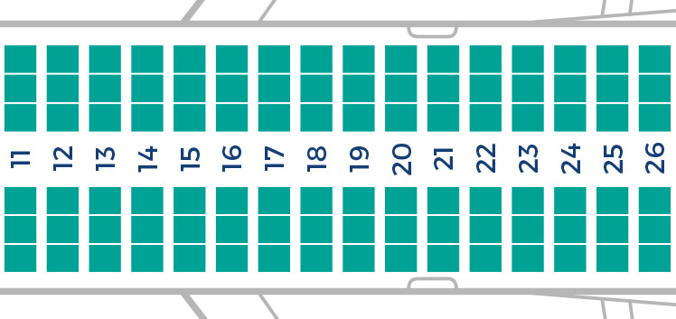
OCCASIONAL TRAVELLERS – NOT ADDRESSED BY LOYATY PROGRAM
occasional travelers
target of multi-partner loyalty schemes
eager to gain variety of accrual and redemption options
desired redemption on award flights
FFPs require strategy for this segment in order expand their customer base and market position
YIELD / FREQUENCY OF TRAVEL

Slide 99
PROPOSITION OF FFPs vs SPENT TYPE
FREQUENT TRAVELERS
INFREQUENT TRAVELERS
Business spend
Private spend
Private spend
Business spend

Slide 100
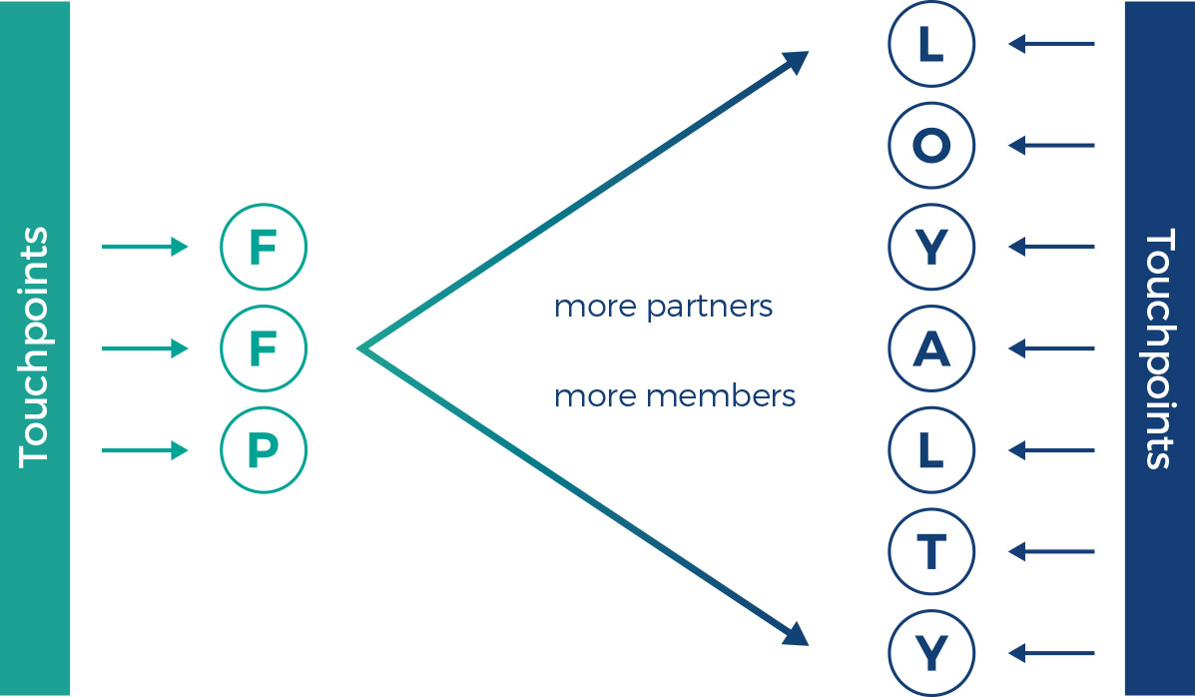
TRANSFERRING FROM FFP APPROACH TO AIRLINE LOYALTY PROGRAMS

Slide 101
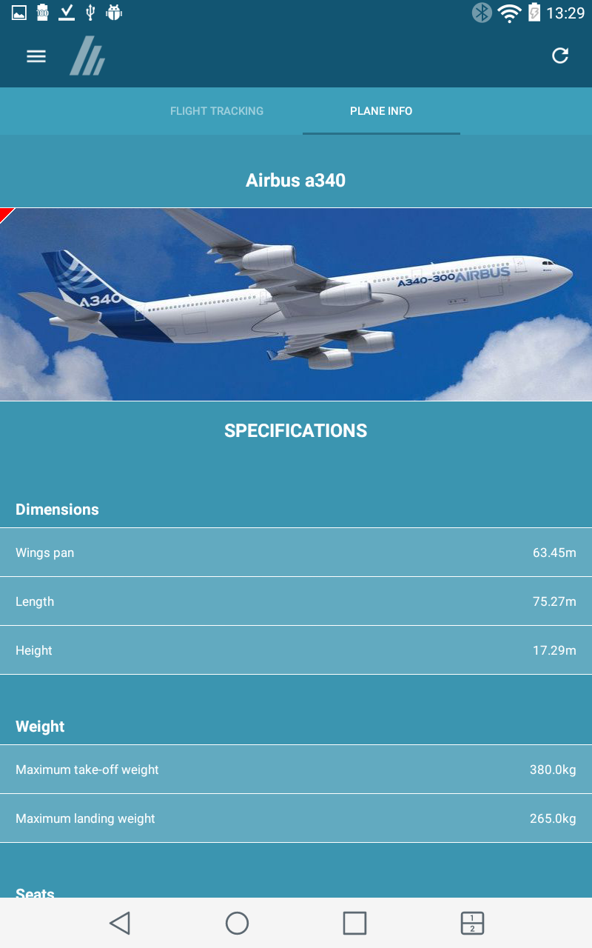
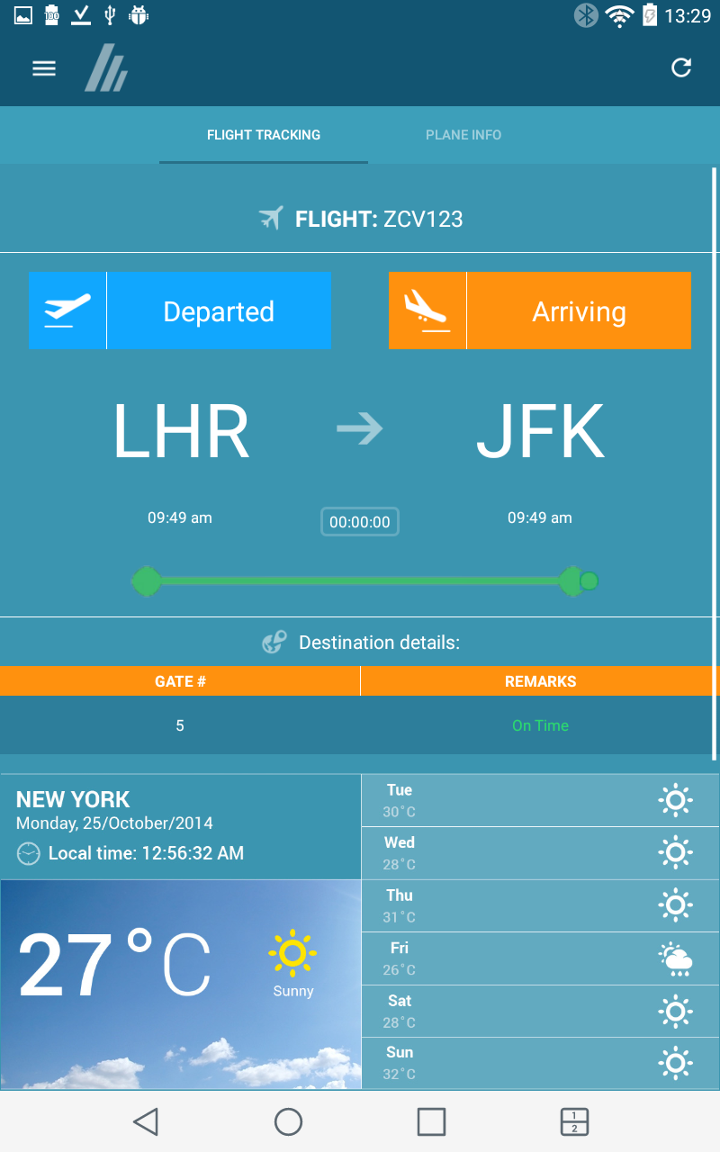
CREW APPLICATION
BUSINESS ADMINISTRATION
Online and offline mode
CONTACT CENTER
MEMBER PORTAL
Passenger list overview
MOBILE APPLICATION
BUSINESS TO PARTNER
Claim service
DATA HUB
Points redemption
CREW APPLICATION
IN-STORE APPLICATION

Slide 102

COMARCH CAMPAIGN MANAGEMENT – SOLUTION OVERVIEW

Slide 103

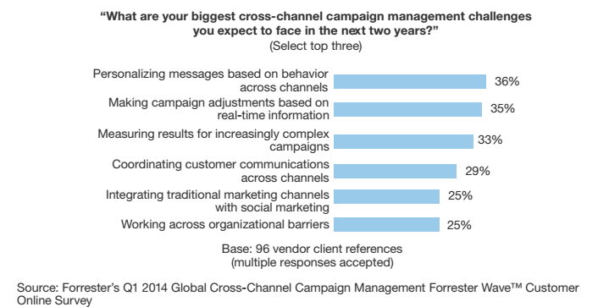
BEHAVIORAL PERSONALIZATION IS THE KEY CHALLENGE

Slide 104
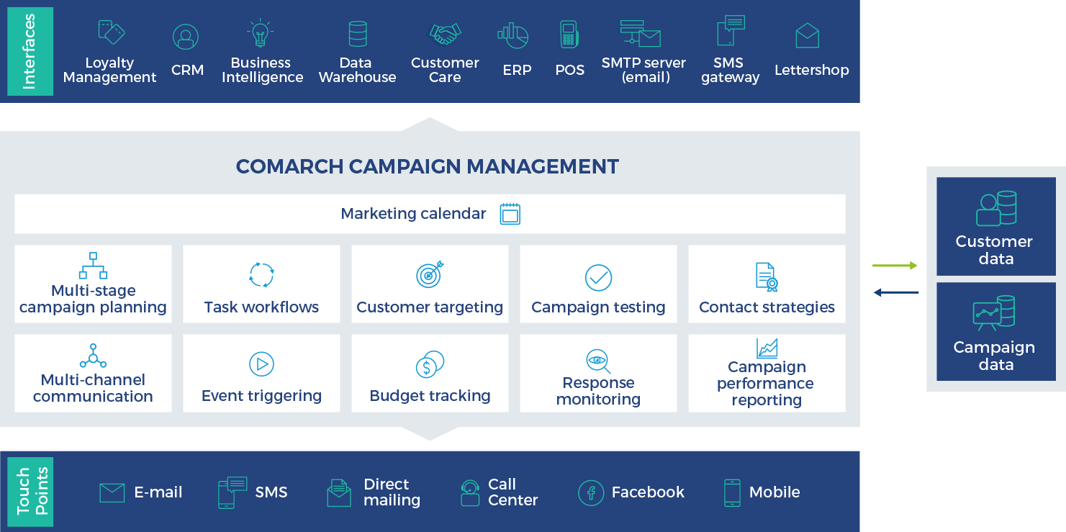
COMARCH CAMPAIGN MANAGEMENT – SOLUTION OVERVIEW

Slide 105
TYPES OF CAMPAIGNS
One-time campaigns
ONE-TIME CAMPAIGNS
Christmas campaign with x% discount for selected products
Multi-stage campaigns
Periodical campaigns
PERIODICAL CAMPAIGNS
Weekly newsletter
Special offer for selected customers sent every Friday
COMARCH CAMPAIGN MANAGEMENT
MULTI-STAGE CAMPAIGNS
Waves of communication triggered by selected customer responses
Simple campaigns
Event-triggered campaigns
EVENT-TRIGGERED CAMPAIGNS
Birthday wishes + offer
SIMPLE CAMPAIGNS
Informational email about new opening hours at stores
Targeted campaigns

Slide 106
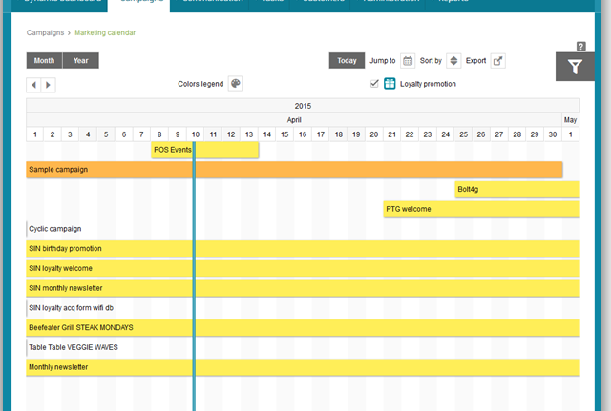
INTERACTIVE MARKETING CALENDAR
monthly/yearly/3years view
drag-and-drop designer
CAMPAIGN PLANNING
CAMPAIGN DESIGN
multiple filters & sorting options
CAMPAIGN BUDGETING
role-based views
CUSTOMER TARGETING
shortcuts & templates
CAMPAIGN WORKFLOW
MULTI-CHANNEL COMMUNICATION
campaign copying
campaign list & export feature
CAMPAIGN TESTING
RESPONSE MONITORING & REPORTING

Slide 107
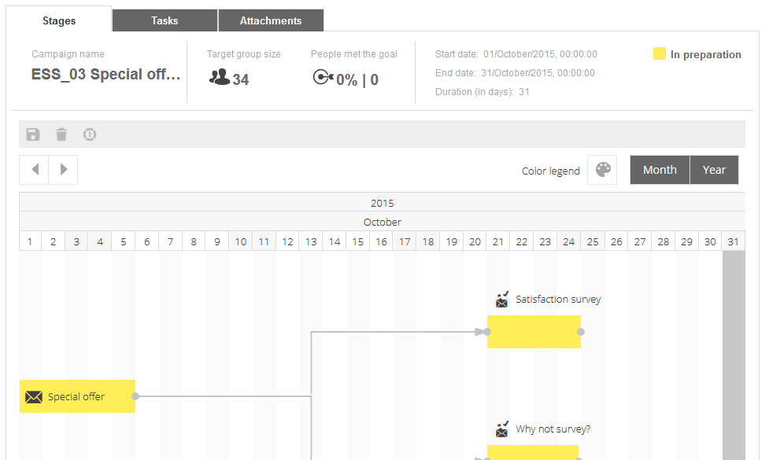
DESIGN MULTI-STAGE CAMPAIGNS
CAMPAIGN PLANNING
CAMPAIGN DESIGN
Definition of Campaign Stages & Conditions
Set-up of Recurring Stages
CAMPAIGN BUDGETING
Drag-and-Drop Campaign Lifecycle
CUSTOMER TARGETING
Autosave Option
CAMPAIGN WORKFLOW
Automation through Event-triggers
Stage Copying
MULTI-CHANNEL COMMUNICATION
Intuitive Tutorial
CAMPAIGN TESTING
RESPONSE MONITORING & REPORTING

Slide 108

MANAGE CAMPAIGN WORKFLOWS & STREAMLINE COLLABORATION
drag-and-drop designer
assignment of default tasks to campaign & stages
reusable workflow templates
email notifications & reminders
attachments & comments
task overview with task timetable/charts/list of today tasks

Slide 109
MANAGE & CONTROL CAMPAIGN BUDGET AND COSTS
CAMPAIGN PLANNING
CAMPAIGN DESIGN
CAMPAIGN BUDGETING
CUSTOMER TARGETING
CAMPAIGN WORKFLOW
detailed categorization of costs
assigning costs to a single campaign & its stages
assigning costs to sponsors/partners
costs splitting between different cost centers
automatic calculation of communication costs
budget planned vs costs spent
fixed & variable costs summary
MULTI-CHANNEL COMMUNICATION
CAMPAIGN TESTING
RESPONSE MONITORING & REPORTING

Slide 110
TARGET RIGHT CUSTOMERS
CAMPAIGN PLANNING
rapid targeting through an easy-to-use graphical wizard
automatic segment refreshment
flexible import & export of target group
contact strategy configuration & execution
automatic contact deduplication
CAMPAIGN DESIGN
CAMPAIGN BUDGETING
CUSTOMER TARGETING
CAMPAIGN WORKFLOW
MULTI-CHANNEL COMMUNICATION
CAMPAIGN TESTING
RESPONSE MONITORING & REPORTING

Slide 111
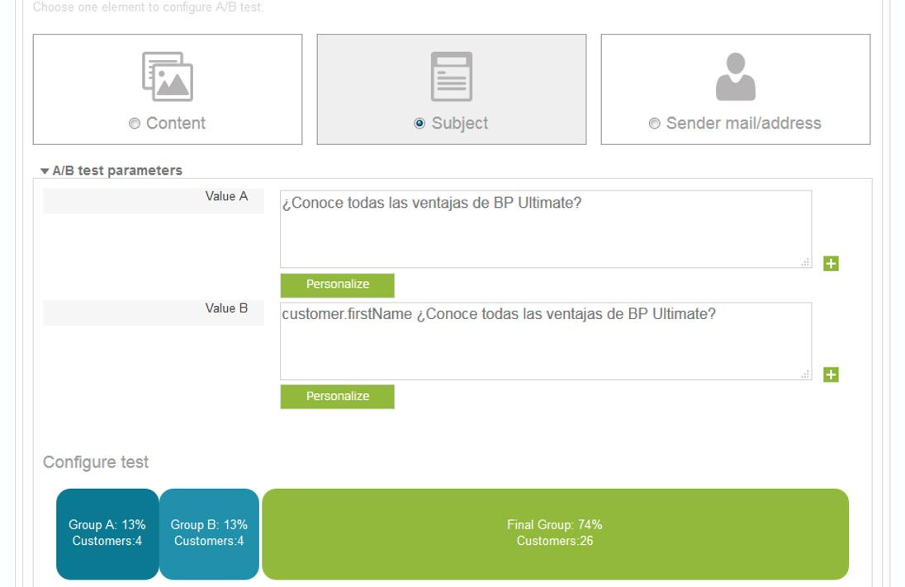
TEST PREPARED CAMPAIGN
Definition of Test Groups
A/B tests
Control Group Setup
Message Content Preview
Multi Preview & Anti-spam Tests (Integration with External Tools)

Slide 112
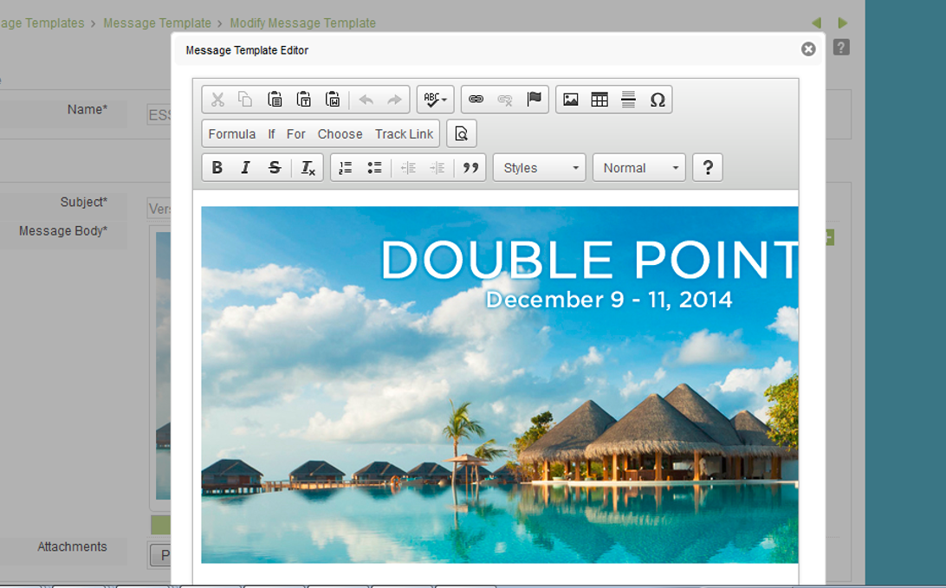
RUN OMNI-CHANNEL COMMUNICATION
CAMPAIGN PLANNING
CAMPAIGN DESIGN
Powerful HTML Message Designer
Coupons Setup
CAMPAIGN BUDGETING
CUSTOMER TARGETING
Dynamic Content Generation
Facebook Posts Scheduling & Publication
CAMPAIGN WORKFLOW
Event-triggered Messages
Contact Rules for Every Channel
MULTI-CHANNEL COMMUNICATION
Online Surveys
Communication Permissions Validation
CAMPAIGN TESTING
RESPONSE MONITORING & REPORTING

Slide 113

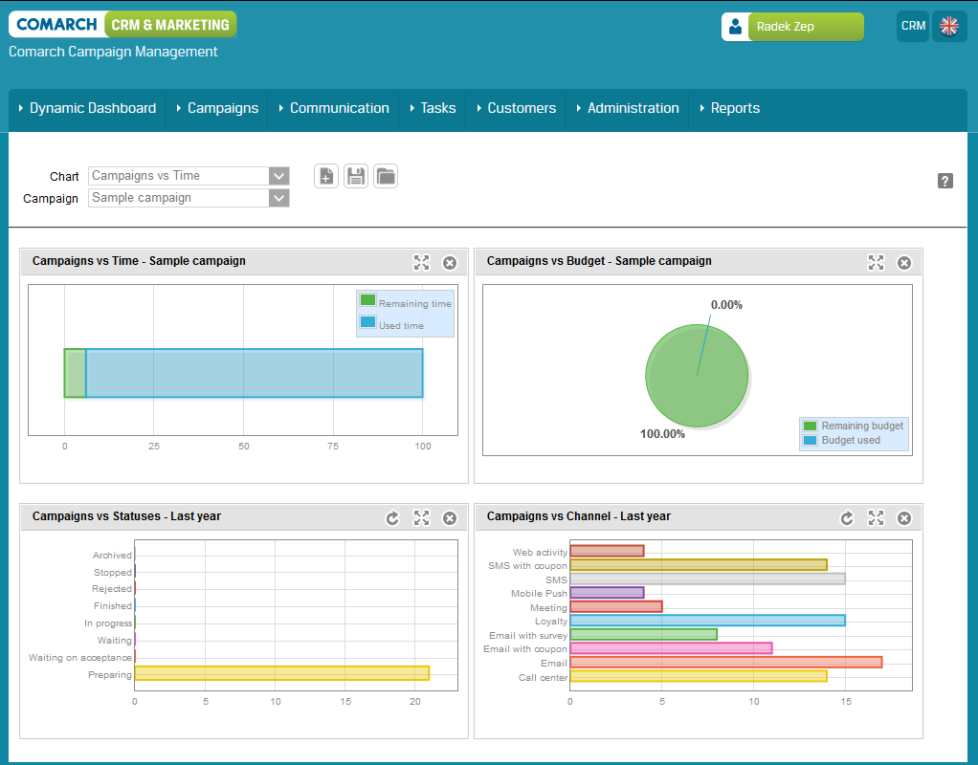
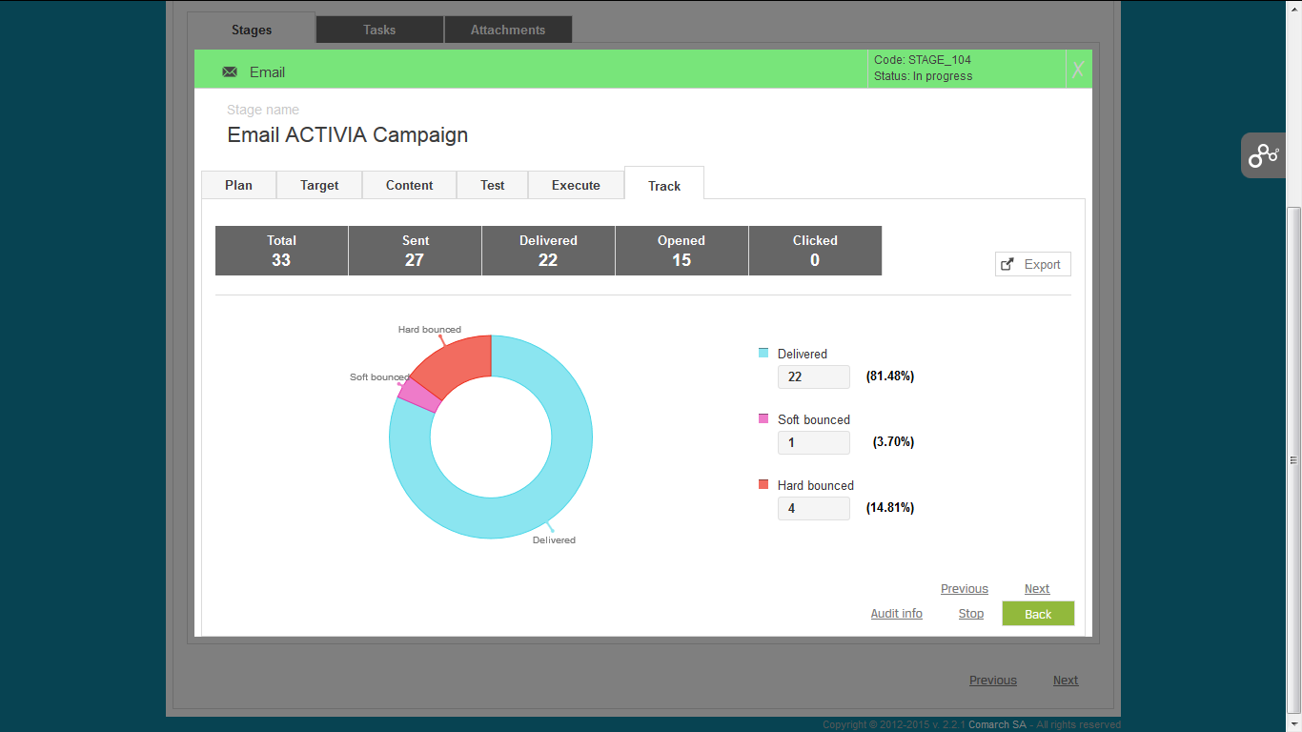
MONITOR & TRACK CAMPAIGN PROGRESS
Dynamic Dashboard – all necessary information about campaigns at a glance
individual results tracking from a particular campaign
real-time email response tracking
opened emails and click-through responses monitoring
delivered and undelivered SMS
individual customer activity tracking

Slide 114




REPORT & ANALYZE CAMPAIGN RESULTS
CAMPAIGN PLANNING
standard report templates across key marketing elements
report templates in different file formats (e.g. PDF, XLS, CSV)
CAMPAIGN DESIGN
CAMPAIGN BUDGETING
CUSTOMER TARGETING
reports can be scheduled, bookmarked, exported and shared across the company
enhanced reports & analyzes provided with the Comarch BI solution
CAMPAIGN WORKFLOW
MULTI-CHANNEL COMMUNICATION
CAMPAIGN TESTING
RESPONSE MONITORING & REPORTING

Slide 115
ADMINISTER & CONFIGURE THE SYSTEM
User Profiles & Permissions Management
Dictionary of Fixed & Variable Costs
List of Products and Locations
Campaign Types
Task Types Definition
Sponsor and Cost Center Administration
Partner Management
Campaign KPIs Definition
System Notifications Setup

Slide 116

KEY BENEFITS
easy handling and management of a large number of multistage campaigns -> faster time-to-market
simplified planning & unified collaboration across the entire marketing team -> coordination of employee work & optimization of resources and efforts
automation of personalized campaigns -> increased revenue and business performance

Slide 117
KEY BENEFITS
visual orchestration of various communication channels-> delivery of great customer experiences
advertising offers tailored to customer needs -> higher response rates, increased retention and customer lifetime value
open & flexible architecture -> painless integration with data sources and system customization

Slide 118




REFERENCES & CURRENT PROJECTS
EFR Group (former Delek France & Benelux)
Tobacco company in Russia
Leroy Merlin Poland
Comarch
2013/2014
2016
2010
2015
L’Occitane Russia
SMU Chile
Large coffee shop chain in the UK

Slide 119

COMARCH CUSTOMER ENGAGEMENT– SOLUTION OVERVIEW

Slide 120

MAIN GOALS
Gamification drives revenue by:
drawing customers into engaging dialogue with a brand
adding something extraordinary to regular activities (everyday shopping)
educating about a brand (brand awareness)
guiding customers (thanks to challenges that encourage them to interact with brand products)
giving instant feedback

Slide 121
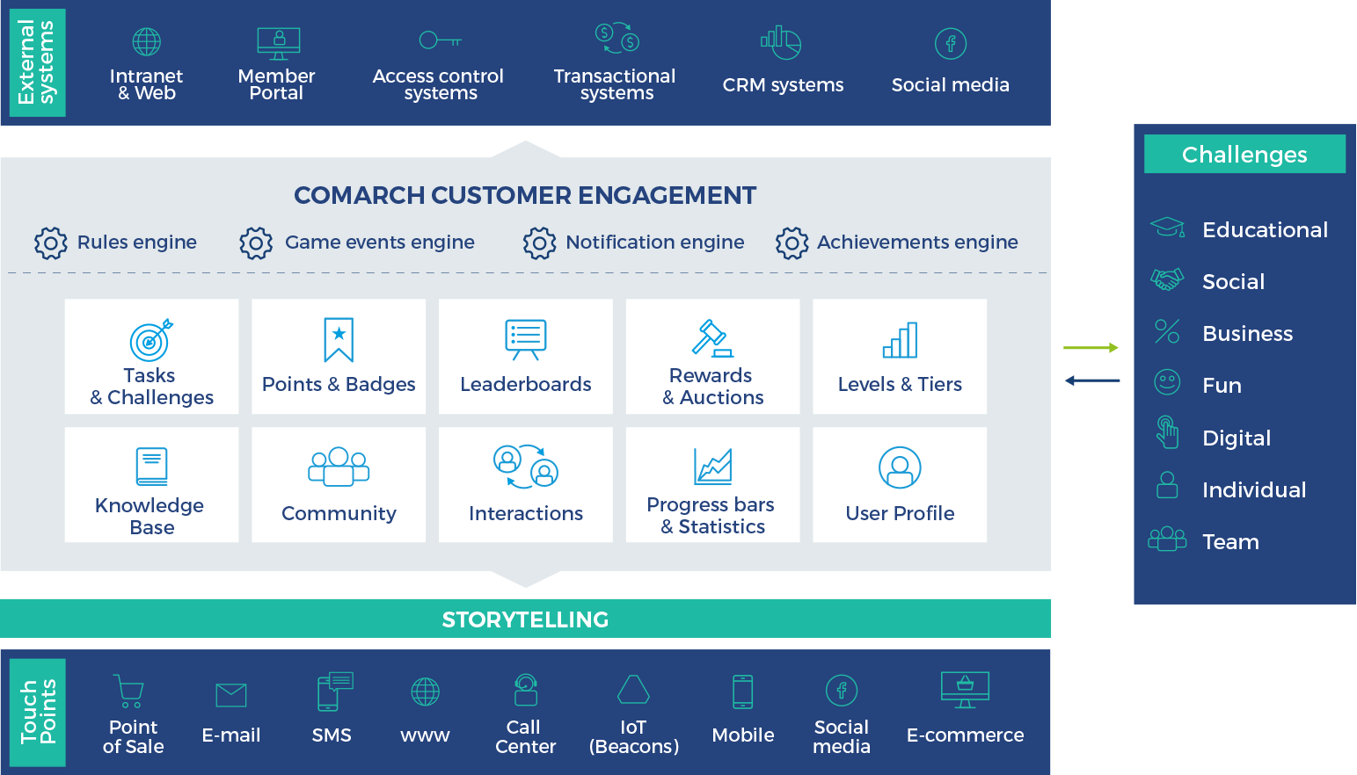
COMARCH CUSTOMER ENGAGEMENT – SYSTEM OVERVIEW

Slide 122

TASKS & CHALLENGES
Purpose & Strategic Objectives:
translate company goals into actions
can be individual or within teams
educational tasks & challenges (values, missions)
social tasks & challenges (…)
gaming tasks & challenges
tasks fulfillment is rewarded and can have time limits.

Slide 123

POINTS & BADGES
Purpose & Strategic Objectives:
a virtual / visual rewarding for defined behaviors
badge = translation of expected behavior or attitude
major impact on customer motivation

Slide 124
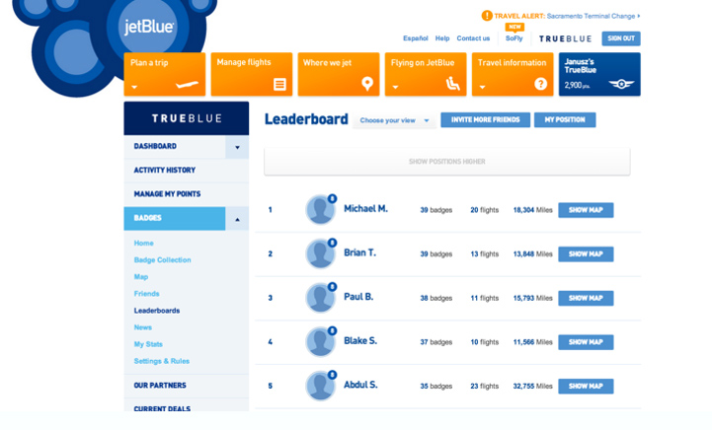
LEADERBOARDS
TASKS & CHALLENGES
POINTS & BADGES
Ranking Purpose & Strategic Objectives:
displays the ”player” position in comparison to the group
ranking depends on the engagement in the project
the Top X can receive special awards
LEADERBOARDS
REWARDS & AUCTIONS
LEVELS & TIERS
KNOWLEDGE BASE
COMMUNITY
USER PROFILE

Slide 125
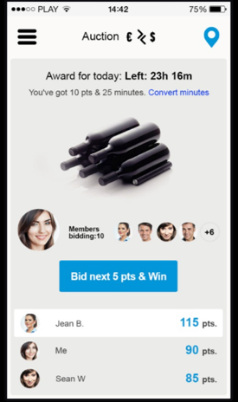
REWARDS & AUCTIONS
TASKS & CHALLENGES
Rewards Catalogue Purpose & Strategic Objectives:
even if less important, physical rewards are motivating
rewards can be different for different actions
rewards can have time or quantity limits
interactive catalogues will generate positive perception
POINTS & BADGES
LEADERBOARDS
REWARDS & AUCTIONS
LEVELS & TIERS
KNOWLEDGE BASE
COMMUNITY
USER PROFILE

Slide 126
LEVELS & TIERS
Make it difficult to master
Purpose & Strategic Objectives:
effective way of appreciating the most active customers
gives the opportunity to differentiate rewards
provides additional incentive for ”lower level” customers
Make it easy to onboard

Slide 127




KNOWLEDGE BASE
Purpose & Strategic Objectives:
Company can deliver necessary information all in one place
Knowledge acquisition can be monitored & tested
Can be enriched by users posts, comments & questions
Certificates can be issued as types of achievements

Slide 128
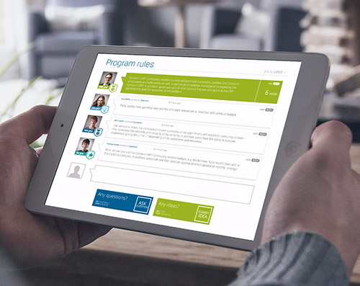


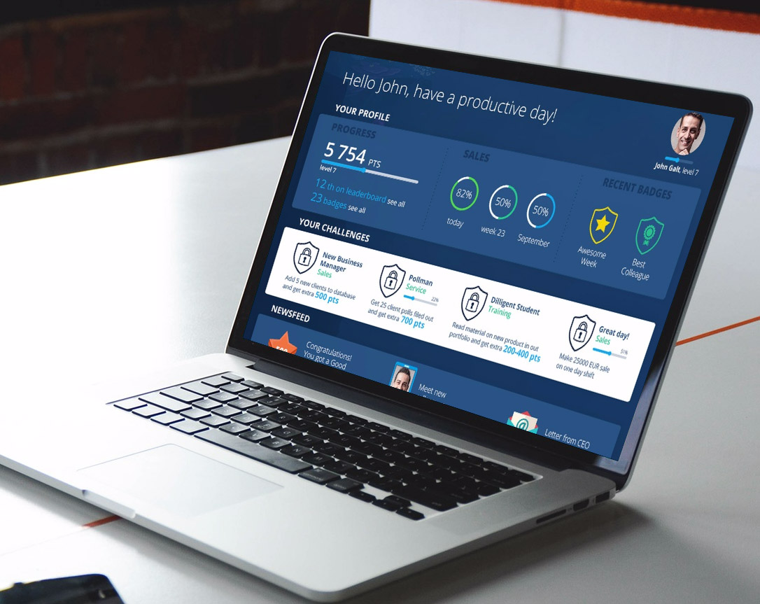
COMMUNITY PURPOSE & STRATEGIC OBJECTIVES
GAMIFIED CROWDSOURCING – SHARING & CREATION OF IDEAS
FEELING OF BEING PART OF AN ACTIVE COMMUNITY
EDUCATION ABOUT PRODUCTS AND SERVICES
TRANSFER OF KNOWLEDGE, MENTORING

Slide 129

INTERACTIONS
Purpose & Strategic Objectives:
interactions between users are crucial
they keep the program engaging and motivating
they are treated as non-material reward

Slide 130
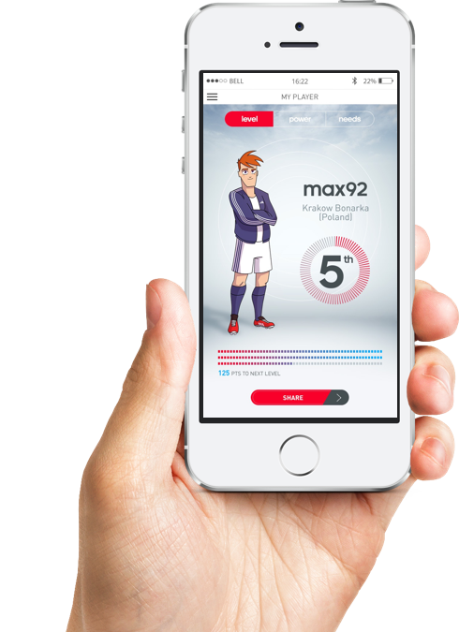
PROGRESS BARS
Purpose & Strategic Objectives:
progress bar is key in driving engagement & commitment
displays progression and achievements
displays tasks & challenges to be performed
instant feedback is crucial with continuous engagement & high motivation levels

Slide 131

KEY BENEFITS
fully-responsive gamified web platform that is easy to use on all kinds of devices — from desktop to smartphones
integrated with Social Media channels such as Facebook and Twitter
contains statistics and reports module to not only gather, but also present dates connected with user's activity

Slide 132
HOW DO WE WORK?
You define:
We define:
overall campaign/topic
expected message to convey
expected behaviors and emotions
expected business results and problems to solve
processes to enhance and many more!
Leaderboards
Badges
Campaign scenarios
Lotteries & contests
Reward auctions
Engagement tasks
Social media
Educational tasks
Communities
Blind auctions
Knowledge base
Omnichannel experience

Slide 133
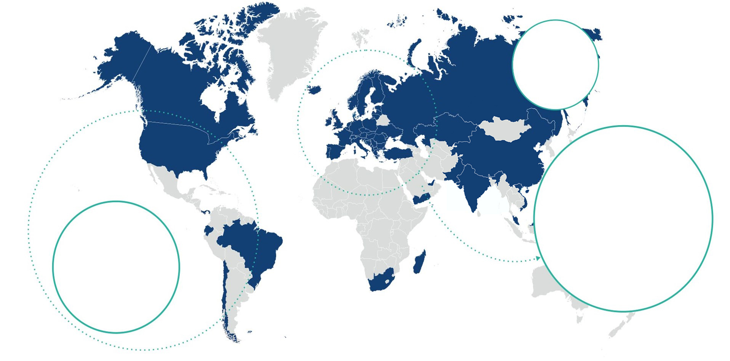



COMARCH ENGAGEMENT GLOBAL PROJECTS
Global FMCG producer
Sportswear leader
Global FMCG producer
Global FMCG producer

Slide 134

COMARCH CUSTOMER CARE – SOLUTION OVERVIEW

Slide 135

BUSINESS CHALLENGES
large number of customer cases
need for fast reaction
requests coming from many different sources (e. g. online chat, e-mail, social media)
lack of a consistent way to track and manage cases and customer complaints
need of reduced case handling time

Slide 136

WE HAVE ALL BEEN THERE
delayed baggage
damaged baggage
delayed flight
flight cancelation
denied boarding
downgrading

Slide 137
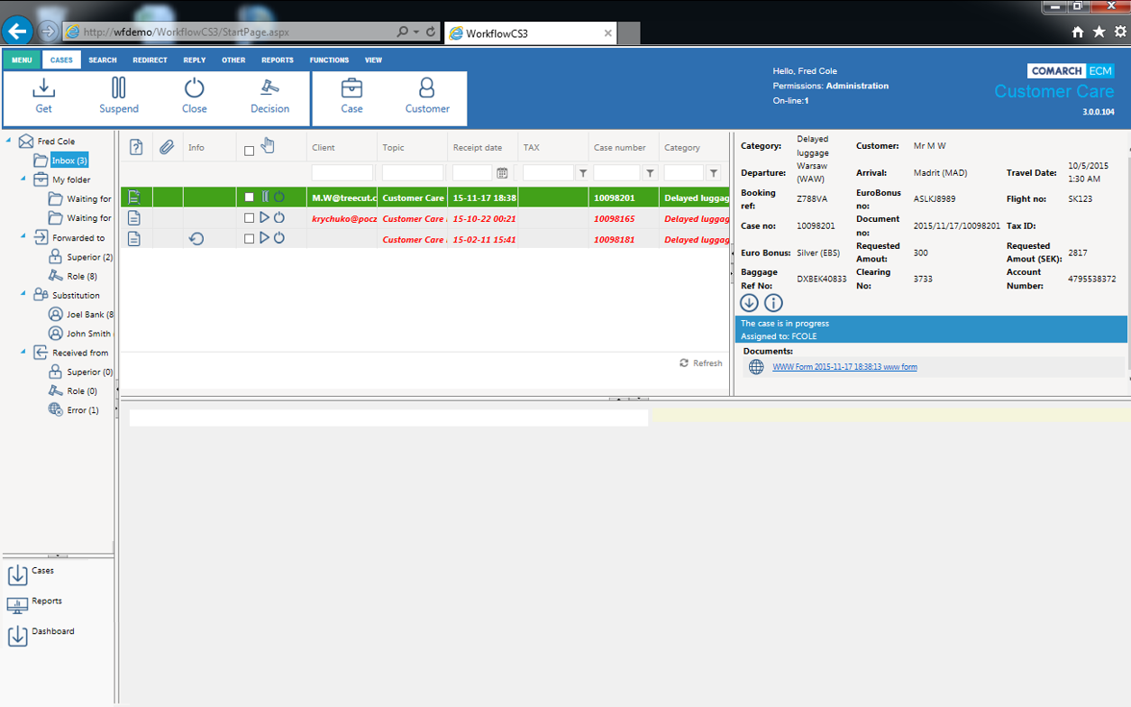
KEY FEATURES
central management for requests coming from different sources
automatic case indexation & categorization
automatic case handling rules
case handling using workflow engine
proactive chat
consultants’ workload check (system makes sure consultants do not have too many open cases)
dashboards with gamification elements
branch related reports

Slide 138
BENEFITS – 3 POINTS OF VIEW
CUSTOMER CARE
MANAGEMENT
EMPLOYEE
CUSTOMER
increased customer satisfaction
reduced costs
control of daily work, costs and performance
higher employee productivity
up-sell possibilities
better key user experience
no repetitive tasks
quicker case resolution
data unification
reduced handling time
less complaints
guarantee for client to access CC by any communication channel

Slide 139

COMARCH BUSINESS INTELLIGENCE – SOLUTION OVERVIEW

Slide 140
ROLE OF BI IN LOYALTY PROGRAMS & MARKETING
Increasing Customer Experience
better customer understanding
ability to personalize Customer Experience in context of:
communication channel
offer & targeting promotions
Better control over the program
rewards management & administration & marketing/ products
customer enrollment efficiency
market basket analysis & sales staff analysis
Points issuance/ redemption
More efficient campaigns management
campaign reporting
campaign optimization
marketing costs analysis
recommendations & scenarios simulations
multi-dimensional customer segmentation

Slide 141






COMARCH BI – FACTS & FIGURES
60 Consultants & Developers
50 Enterprise BI projects
11 countries
600,000 customers integrated
12 years of experience
7,000 users with licenses
300,000 monthly delivered reports
9 R&D projects
84 days of work saved after one Comarch BI implementation

Slide 142

KEY CHALLENGES FOR MARKETING ANALYTICS
Which channel should I use to increase response rate?
Which products are being sold together?
Who is my typical client? How can I encourage more of them?
To whom shall I direct my next campaign?
Which products are my bestsellers now and why?
Which products are being sold more often in location A than in location B and why?

Slide 143
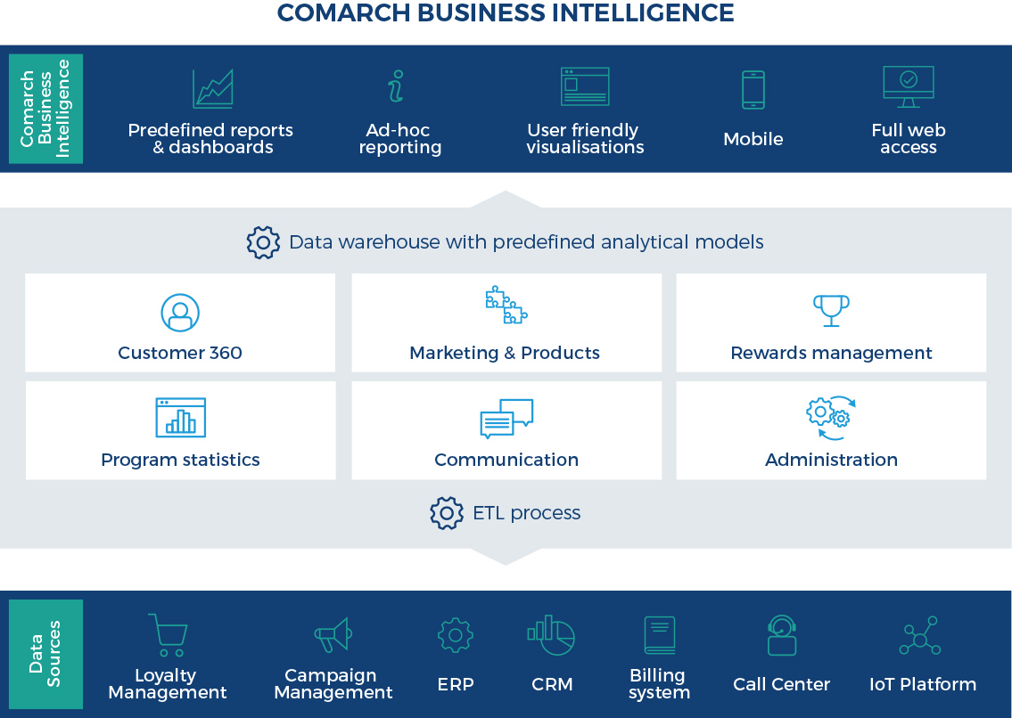
COMARCH BI – SOLUTION OVERVIEW

Slide 144


COMARCH BI – KEY FEATURES
Dashboards
Many forms of visualizations:
graphs
indicators
tables
maps…
Reports
ad-hoc reporting
drag & drop
export mechanism (xls, pdf..)
reports subscriptions
Collaboration
reports repository
sharing mechanism
uploading Excel and RS reports
permissions system

Slide 145

COMARCH BI – KEY FEATURES
Dashboards
Many forms of visualizations:
graphs
indicators
tables
maps…
Reports
ad-hoc reporting
drag & drop
export mechanism (xls, pdf..)
reports subscriptions
Collaboration
reports repository
sharing mechanism
uploading Excel and RS reports
permissions system

Slide 146

COMARCH BI – KEY FEATURES
Dashboards
Many forms of visualizations:
graphs
indicators
tables
maps…
Reports
ad-hoc reporting
drag & drop
export mechanism (xls, pdf..)
reports subscriptions
Collaboration
reports repository
sharing mechanism
uploading Excel and RS reports
permissions system

Slide 147
ANALYTICAL MODELS DESCRIPTION
CUSTOMER 360
MARKETING & PRODUCTS
REWARDS MANAGEMENT
PROGRAM STATISTICS
customer- based information
analysis based on: customers quantity, account status, issued and redeemed points, contact channels
who exactly customers are and which of them are most profitable
analyzes information from issuance and redemption angle
customers segmentation
determine promotions effectiveness+ impact on revenue
more personalized offers
points redemption analysis
information about: redeemed points, value and quantity of transactions, value and quantity of reward products,
redemption partners analysis
information about: number of customers, accounts types and status, redeemed and accrued points
ability to examine most efficient transaction channels
insight into loyalty and non- loyalty data

Slide 148
ANALYTICAL MODELS DESCRIPTION
COMMUNICATION
CAMPAIGN MANAGEMENT
ADMINISTRATION
concern contact center activities, status and type of messages
optimize contact strategies
improve contact centers operations
develop stronger relationships with customers
product campaigns
campaign efficiency
campaign goals monitoring (KPI’s)
better insight into marketing costs and budget
tracking individual campaign results
provide statistics regarding account changes and user roles
information about number of users and their types
monitor user roles and modifications
improve account administrators work

Slide 149





EXAMPLES OF PREDEFINED DASHBOARDS & REPORTS
Aggregate, multi-section data facilitating decision making in loyalty programs
Revenue Analysis
Promotion Efficiency
KPI for Chosen Loyalty Program Indexes
Partner Summary
Customer 360 View
Enrollment Efficiency
Call Center Operations
Top Rewards Details
Program/Campaign State
CPP – Cost Per Point Analysis

Slide 150


EXAMPLE SOLUTION ARCHITECTURE
DATA SOURCES
INTEGRATION
REPOSITORIES
ANALYTICS
USERS
Data bases
Reporting tools
Business user
Reports repository
Flat files
ETL
Comarch DWM
Data Warehouse
Data marts
OLAP cubes
Data analyst
Excel
Data models repository
/ analytical Data Marts
XML files
Analytical environment
Data scientist

Slide 151










END-TO-END BI SOLUTIONS DEDICATED FOR DIFFERENT INDUSTRIES
BRANCHES
SOLUTIONS
TECHNOLOGIES
Telecom
Finance
FMCG/Retail
Airlines
Government
Healthcare
Logistics
Consulting
Implementations
Development
Services, Outsourcing & Cloud solutions

Slide 152

KEY BENEFITS
identification of customer behavior, needs and opinions → increased customer retention
identification of buying patterns → increased purchase frequency
identification of key factors driving loyalty → increased overall program effectiveness
identification of customer lifestyle and preferences → tailored offers, mailings, rewards, privileges

Slide 153

KEY BENEFITS
identification of highest value customers → improved profitability & savings
evaluation of marketing campaigns → increased response rate
identification of loyal customers everywhere they interact with a brand → knowledge regarding customers in multiple touch points

Slide 154

COMARCH SOCIAL MINING – SOLUTION OVERVIEW

Slide 155

COMARCH SOCIAL MINING – SYSTEM OVERVIEW

Slide 156

WHY SOCIAL MEDIA MONITORING IS IMPORTANT IN MARKETING?
SOCIAL MEDIA LISTENING – ability to verify what audience says about business
KNOW CUSTOMERS BETTER – ability to improve marketing strategy
SENTIMENT ANALYSIS – understanding customer behaviour and its relation to the business and competitors’ brands
ENRICHED CUSTOMER PROFILE – possibility to segment customers based on additional data
KEYWORDS ALERTS – ability to monitor posts and comments about brand and topics of the highest importance

Slide 157

COMARCH SOCIAL MINING – MAIN CAPABILITIES
Easy to use social media monitoring tool that allows to:
shift approach to social media from an isolated marketing channel, to an integrated part of loyalty management processes
identify and listen to online conversations, engagements, keywords and mentions based on user defined criteria
analyze behavior of customers in social media to measure engagement, define marketing strategy and target groups for promotions
enrich of customer profiles in Comarch Loyalty Management with social data

Slide 158

COMARCH SOCIAL MINING – MAIN CAPABILITIES
Easy to use social media monitoring tool that allows to:
monitor social content performance on selected social media profiles and its life time
display the most meaningful scores in customized dashboard
provide reports and unique KPIs to better analyze brand’s presence in social media
detect required activities thanks to automated notification system

Slide 159
KEY FEATURES
COLLECT
LISTEN
ANALYZE
connection with loyalty program member profile in Comarch Loyalty Management
enriching customer information with social data including aggregated behavioral data
capturing of detailed customer activity related information from Facebook and Twitter
grouping activity based on user defined criteria in the Spheres module
usage of sentiment analysis
ability to track keywords and topics of the highest importance
monitoring of loyalty program members interaction with a specific type of content
identification of the most engaged customer segments
unique numerical data
effectiveness of social media content score
positive/neutral/negative sentiments distribution ratio
social campaign life cycle
customer social behavior and engagement analysis
customer demographics
customer ranks and segmentation
analysis of the opinion leaders and influential social media users

Slide 160


SPHERES
user defined phrases or keywords
all significant data published in social media flow into the CSM
sphere related statistics, such sentiment analysis, keywords comparison, contextual insight, social profiles and users related statistics
monitoring of specific social media profiles in the form of search queries
leveraging the vast amount of conversations available in social media for various business purposes

Slide 161

CUSTOMER MANAGEMENT
Complete information regarding social media users divided by:
LOYALTY PROGRAM MEMBERS
OTHER SOCIAL MEDIA USERS
integrated insight to improve customer experience
user data and statistics from Facebook and Twitter
customer’s social account - URL to Facebook or Twitter profile
communication history on timeline – detailed posts, comments and tweets along with attributes
segments – information regarding CLM segment classification
public user data and statistics available in social media
ability to view customer’s profile - URL to Facebook or Twitter profile
communication history on timeline – public posts, comments and tweets along with attributes

Slide 162

CONTENT REVIEWER
list of content published on Facebook fan pages and Twitter accounts connected with CLM
statistics regarding effectiveness of all published content
analysis of user’s activities and engagements
content performance metrics within the selected time period
relevant statistics & analysis
desired outcomes in terms of likes, shares, followers and retweets
history of the most successful social activities

Slide 163
KEY BENEFITS
centralized and unified social activity research
efficiency monitoring into a single, filterable tool
trends analysis against competitors
consolidated customer experience focus thanks to integration with Comarch Loyalty Management
management of brand presence in social media
access to information on the involvement of customers and their spontaneous comments
ability to focus on the most influential customers and brand ambassadors
improved segmentation based on additional social attributes of customers
monitoring and measurement of social campaigns
improved quality of communication with customers

Slide 164

PRODUCT RELEASE POLICY

Slide 165
COMARCH LOYALTY MANAGEMENT RELEASY POLICY
PATCH SETS
MAINTENANCE RELEASE
MINOR VERSION
MAJOR VERSION
if needed
every 10-12 weeks
every half a year
every 4-6 years
published after the detection of a critical bug
included in the support agreement
includes bug fixes as update packs and additional small functions ordered by specific customers (CR’s)
groups maintenance releases as well as newly developed functions
related to a major technological change
for customers using older major version of the system, an upgrade to the latest version involves carrying out an entire implementation project
Comarch does not force clients to implement a new major version and continues to support older ones

Slide 166

PROJECT METHODOLOGY

Slide 167
SOFTWARE DEVELOPMENT PROCESS – PROJECT PHASES
RequirementsAnalysis
System Roll-out
Technical Design
System Adaption
System Configuration
QA Tests
Trainings
Implementation
multiple stages
waterfall model
each phases output will be an input for the next phase
detailed plan for the next phase developed at the end of each phase compilation

Slide 168
PRELIMINARY PROJECT SCHEDULE
ANALYSIS
[date from]
[date to]
DESIGN / SPECIFICATION
[date from]
[date to]
DEVELOPMENT
[date from]
[date to]
IMPLEMENTATION / DEPLOYMENT
QA TESTS
[date from]
[date to]
[date from]
[date to]
GO-LIVE [date]

Slide 169

CHANGE MANAGEMENT

Slide 170
QUALITY & SECURITY STANDARDS
We focus on QUALITY
General standards:
Comarch Information Security Policy
Quality Management System
PN-EN ISO 9001:2001
PN-EN ISO 14001
PN-N-18001
EN-ISO/IEC 27001:2007
Comarch Data Center standards:
Personal Data Security Policy
ITIL v3 – process approach
ISAE 3402 (SAS-70)

Slide 171

COMARCH CERTIFICATES

Slide 172

SOLUTION ARCHITECTURE

Slide 173

SYSTEM ARCHITECTURE

Slide 174
EXPERIENCE IN INTEGRATION WITH 3rd PARTY SYSTEMS
POS
CRM
INDUSTRY SPECIFIC
OTHER
IBM
Retalix
Wincor Nixdorf
Micros EPOS (3700andSimphony)
Micros EPOS (InnTouch/Caterwide)
Tokheim
Gilbarco Wayne
Integration with different POS via VISA/AMEX/MasterCard
External campaign management systems: IBM Unica, Adobe Campaign, Responsys, Exact Target
SAS
Airlines
Navitaire
Sabre
Mercator
Datalex
SITA (DCS)
Amadeus
Sirena
OpenJaw
HP
Financial services:
Oracle Financials
SAP FI
SAP
IBM Netezza
redemption platform Epsilon
IVR system
Invoicing systems
Email servers
SMS gateways

Slide 175



ALLIANCE INTEGRATION

Slide 176

ONGOING SERVICES

Slide 177

HOSTING SERVICES

Slide 178

COMARCH DATA CENTER FOOTPRINT

Slide 179

COMARCH DATA CENTER IN NUMBERS

Slide 180

COMARCH DATA CENTER – RANGE OF SERVICES
Software as a Service (SaaS) - complete customer service in the delivery of applications and hardware (HW & SW) in a service model
Platform as a Service (Paas) - hosting platform services (HW & SW) for client applications
Infrastructure as a Service (IaaS) - virtualized platform available in the "On-demand” model
Comarch Disaster Recovery - backup data centers

Slide 181
COMARCH DATA CENTER – RANGE OF SERVICES
Comarch’s Application
DB Administration
OS Administration
Monitoring
Storage
Backup
HW Platform
Virtualization
Network & Security

Slide 182
BENEFITS FOR USERS
Optimizing expenses (OPEX / CAPEX)
Flexibility and competitive prices
Turnkey Solutions (HW & SW)
The high quality of service (defined by SLA)
Many years of experience in the field of ICT services and industry knowledge
Ability to connect global standards with local customer requirements
Appropriate technical background to support projects 24/7
A safe environment for your information systems

Slide 183

MANAGED SERVICES – GOING BEYOND TECHNOLOGY

Slide 184

SUPPORT OF ENTIRE LOYALTY LIFECYCLE

Slide 185

MANAGED SERVICES SCOPE

Slide 186
SUPPORT & MAINTENANCE

Slide 187


DEFECTS & CHANGES HANDLING
loyaltysupport.comarch.pl
Defects (bugs)
Questions
Change requests
Tasks
Changes in configuration
Enhancements
JIRA TICKETS

Slide 188
THREE LINES OF SUPPORT
Service levels:
BRONZE
SILVER
GOLD
JIRA workflow
Defect fixes:
emergency fixes
periodic patches
Tests
KPI's reporting
loyaltysupport.comarch.pl
JIRA TICKETS
1st LINE SUPPORT
2nd LINE SUPPORT
3rd LINE SUPPORT
Service Desk
Back Office
Production
Data Center

Slide 189

SLA LEVELS

Slide 190

COMMERCIAL PROPOSAL

Slide 191
PROPOSED SOLUTION PRICING
 | Name | Net price
COMARCH LICENSES | Business Administration module | 0,00 EUR
 | Contact Center module | 0,00 EUR
 | Member Portal module | 0,00 EUR
 | …. | 0,00 EUR
IMPLEMEN- TATION | module | 0,00 EUR
 | module | 0,00 EUR
 | module | 0,00 EUR
 | … | 0,00 EUR
 | Implementation | 0,00 EUR
 | Total: | - EUR

Slide 192
PROPOSED SOLUTION PRICING – ONGOING COSTS
Name |  | Net price | Cost/month
ONGOING COSTS (MONTHLY FEE) | Technical Support & Maintenance services | 0,00 EUR | EUR
 | Hosting | 0,00 EUR | EUR
 | Managed Services | 0,00 EUR | EUR
 | … | 0,00 EUR | EUR
 | Total: |  | - EUR

Slide 193

facebook.com/comarchCRM
twitter.com/Comarch_CRM
youtube.com/comarchTRADE

